Slide 1
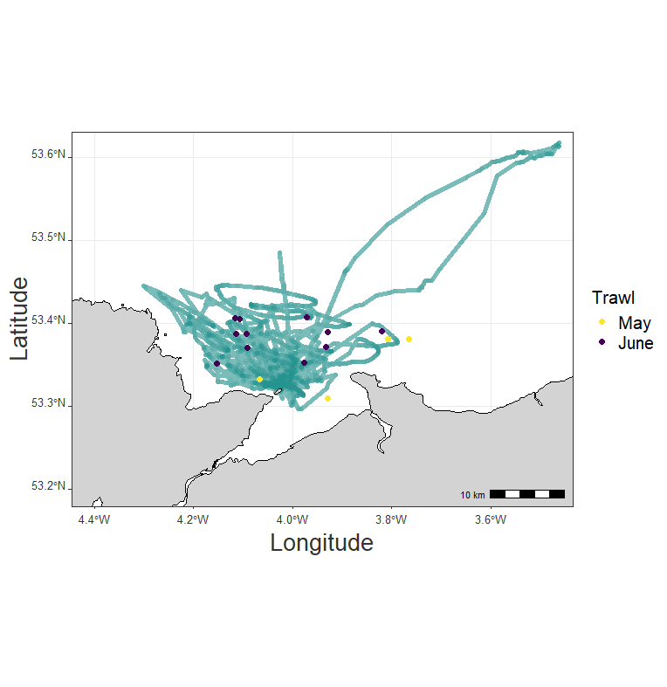
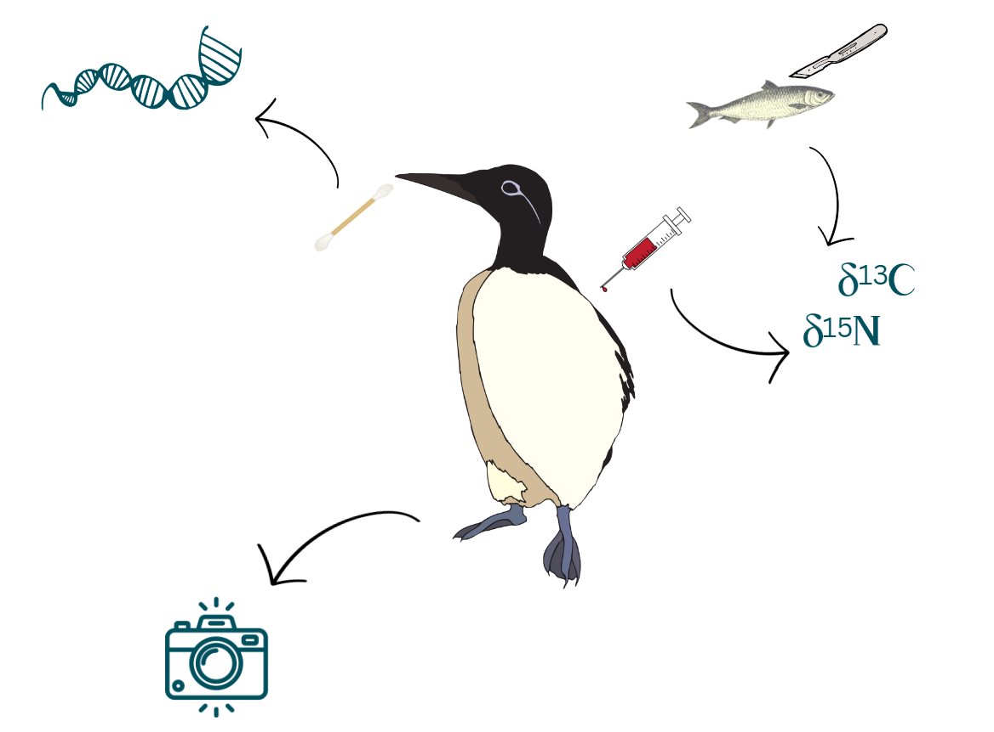
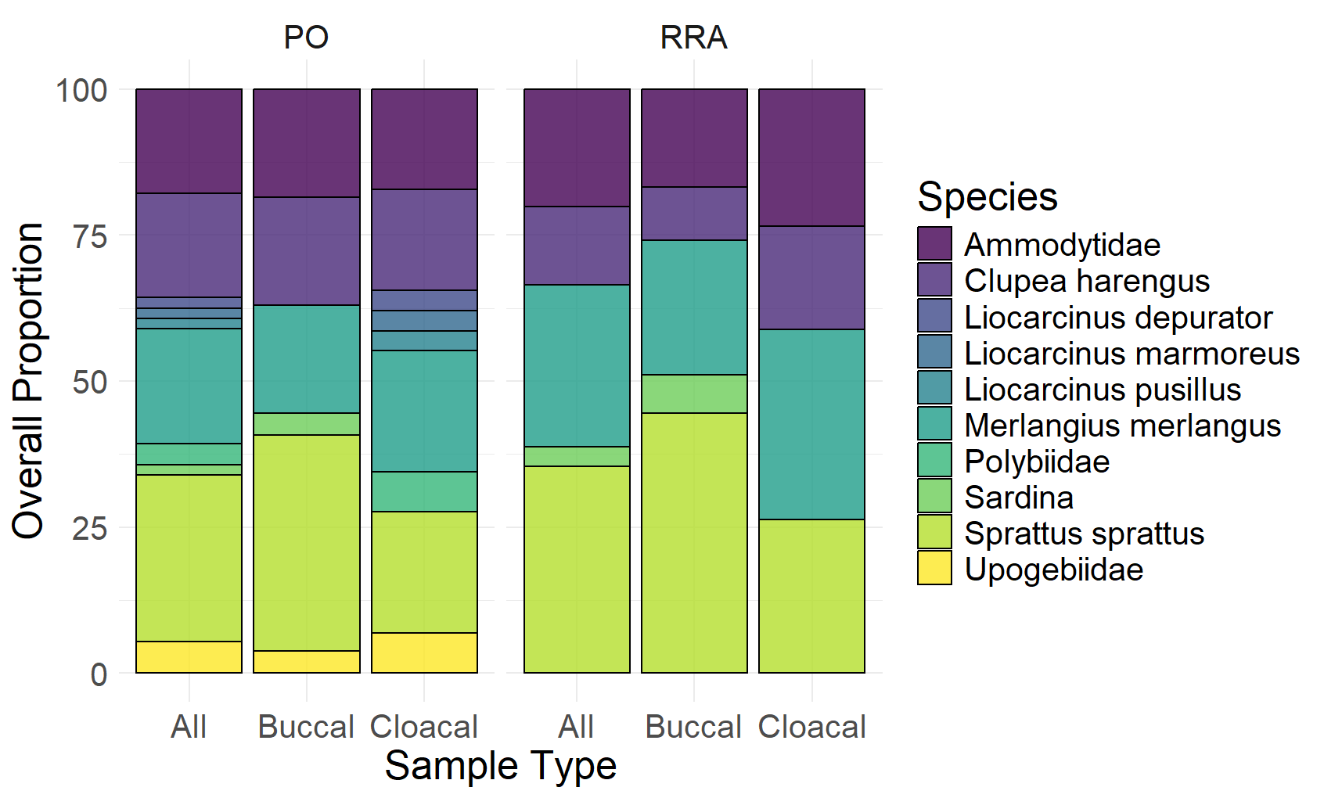
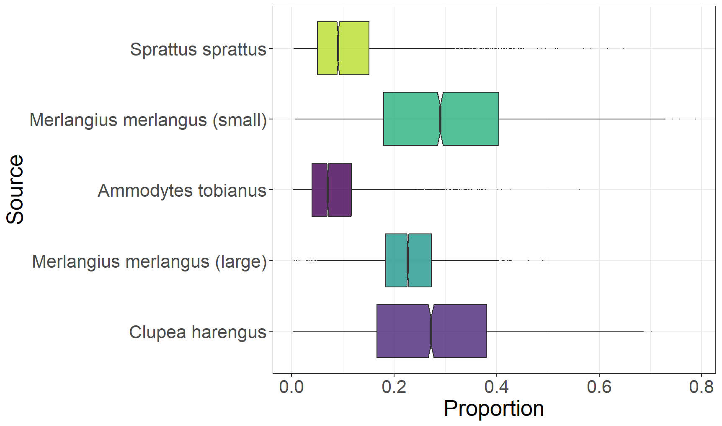
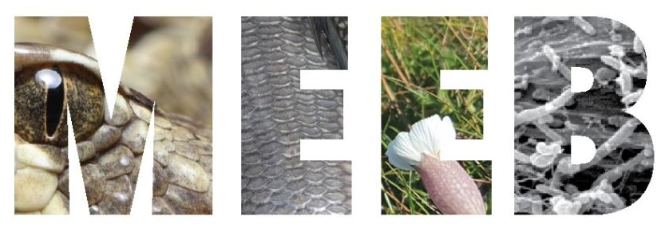
Combining DNA metabarcoding and Stable Isotope Analysis for Diet Studies in a Diving Seabird
Amelia Corvin-Czarnodolski¹, Jonathan A. Green², Simon Creer¹, Amy Ellison¹, Rosemary Moorhouse-Gann¹, Claire Carrington¹, Shaun Fraser³, Steve Dodd⁴, James Waggitt¹, Katrien Van Landeghem¹, Olivia Hicks^{1,2}
¹Bangor University ²University of Liverpool ³University of Highlands and Islands ⁴RSPB
mlc23srh@bangor.ac.uk
@amelia_corvin
Background
Dietary information can indicate marine ecosystem health¹, aid fisheries management and explain habitat selection²
Seabird survival and productivity depend on prey quality and availability³, but seabird diet samples are often degraded or opportunistic
Adult guillemot diet is largely understudied on the West coast of the UK
Combining multiple methods and novel samples could help accurately reconstruct adult guillemot diet ⁴ and aid in understanding local ecosystem interactions
Spatiotemporal Predator-Prey Overlap
Birds sampled in June 2023, n = 17
DNA Metabarcoding:
Buccal & Cloacal Swabs
Temporal scales
DNA: hours – days
SIA: days – a week
Ynys Môn
(Anglesey)
Colony: Puffin Island, UK
Stable Isotope Analysis:
Blood Plasma (Bird) & Muscle Tissue (Fish)
North Wales
Potential prey species were collected in the guillemots’ foraging area (n = 15) in May and June 2023
Photos:
Chick
Provisioning
Common Guillemot, Uria aalge
DNA Metabarcoding
Results
Stable Isotope Analysis
% Occurrence (All)
Relative read abundance (Fish)
Overall proportions of prey in the diet,
calculated using different metrics
SIMMR mixed model
2 x 16S primers:
Fish & Decapod
Sources informed by DNA & Trawls
Conclusions
Whiting and clupeids are important adult guillemot prey species during early chick rearing
Molecular methods show greater diet diversity in adult guillemots than suggested by observations of chick provisioning
Buccal and cloacal swabs are an effective new sampling method for seabird diet studies, allowing quick and systematic sampling
Stable isotope analysis must be informed by prior knowledge of the study system to obtain realistic results
Using complementary methods can reduce bias and maximise our understanding of seabird diet content and proportions
Understanding these predator-prey interactions can help explain habitat selection and be useful for informing OWF developments
References: ¹Sydeman, W. J. et al. Hemispheric asymmetry in ocean change and the productivity of ecosystem sentinels. Science 372, 980–983 (2021). ²Romero, J., Catry, P., Alonso, H. & Granadeiro, J. P. Seabird diet analysis suggests sudden shift in the pelagic communities of the subtropical Northeast Atlantic. Marine Environmental Research 165, 105232 (2021). ³Kowalczyk, N. D., Chiaradia, A., Preston, T. J. & Reina, R. D. Linking dietary shifts and reproductive failure in seabirds: a stable isotope approach. Functional Ecology 28, 755–765 (2014). ⁴Chiaradia, A., Forero, M. G., McInnes, J. C. & Ramírez, F. Searching for the True Diet of Marine Predators: Incorporating Bayesian Priors into Stable Isotope Mixing Models. PLOS ONE 9, e92665 (2014).
This project was funded by the NERC ECOWind-ACCELERATE project (NE/X008886/1) and the Craig Kensler Studentship.

