Slide 2
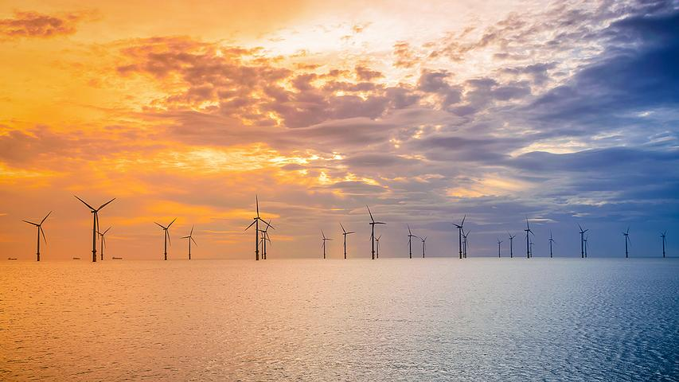
Establishing a Framework for Quantifiable Evidence and Impact of Ecosystem Change Throughout the Lifecycle of UK Floating Offshore Wind Farms EQUIFy
PML: Matthew Palmer, Ana Queiros, Steve Watson, Claire Szosteck, Tom Mansfield, Juliane Wihsgott, James Clark, Claire Widdicombe, Elaine Fileman, Saskia Ruhl, Riqui Torres, Marius Dewar, Yaru Li + modelling team, James Fishwick + SmartSound team, Quillie Erskine (PM)
Aberdeen: Beth Scott, Neda Trifonova UHI: Benjamin Williamson + PDRA NOC: Julie Robidart + team
Cefas: Jeroen van der Kooij, Veronique Creach, Tom Hull, James Scott and team
Oxford: Taka Nishino, Emma Edwards, Chris Vogel MetOffice: Segolene Barthou
Plymouth: Deborah Greaves, Lars Johanning, Martyn Hann +PDRA

Slide 3
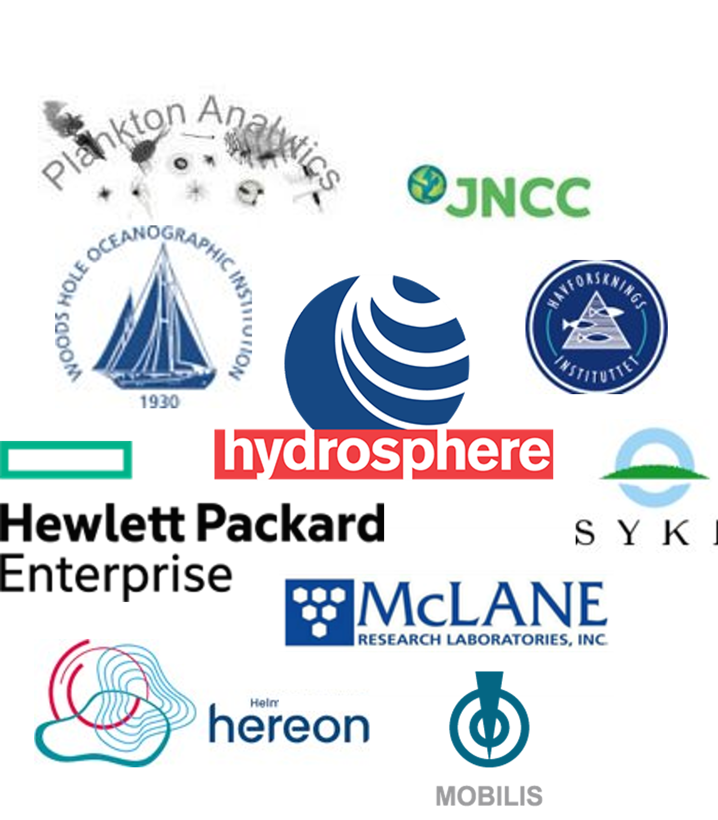
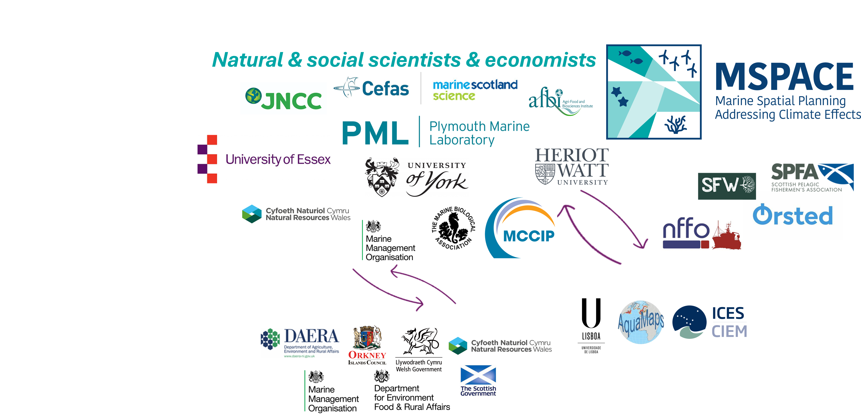
Co-design & co-delivery
PELAgIO
iFLOW
APICS

Slide 4
Why?
H1: On a local scale within FLOW farms, mixing will increase and drive change within local primary productivity, phytoplankton community dynamics and fish, bird and mammal abundance and behaviour.
H2: On a regional scale (up to 100 kms), FLOW will result in a less energetic atmosphere and modified ocean currents, with immediate effects on mixing, primary production, plankton community structure and higher trophic levels and ecosystem function. These changes present a legacy of cumulative effects for future years.
H3: Impacts over large-scale and long-term from expansion of FLOW will be modified by the changing use of our seas and by climate change, but the degree to which such impacts can be managed will be constrained by the pace and scale of UK energy infrastructure developments and public support for change.

Slide 5
How?
WP1: Co-Development & Co-Delivery (Palmer & co-PIs)
T1.1 Co-development with Stakeholders: SAG with M6 Stakeholder workshop.
T1.2 Data Architecture: working with MDE and MEDIN.
T1.3: Deliver Quantifiable Evidence: Technical workshop & solutions roadmap (M38), Stakeholder workshop (M44).
WP2: Optimal representation of FLOW in our models (Greaves, Nishino & Torres)
T2.1: FLOW-turbine parameterisation: in WRF/FVCOM (M18)
T2.2: FLOW-farm parameterisation: in UM/NEMO (M24)
T2.3: Predicting ecosystem impacts from FLOW in the Celtic Sea (M26-30)
T2.4: Contemporary and future climate regional scale impacts of FLOW: (M30-34)
WP3: Improving monitoring of ecosystem sensitivity to physical impacts from FLOW (Wihsgott & Clark)
T3.1: Quantify FLOW impacts on hydrodynamics, mixing and air-sea interactions: building on ECOWind (M18)
T3.2: Develop and test new ways to monitor and assess environmental effects of FLOW: utlising the SmartSound facility
T3.2.1 Resolve plankton sensitivity to environmental drivers: building on historical timeseries (M24)
T3.2.2 Uncrewed Surface Vehicle (USV) ecosystem monitoring demonstrator: including fisheries acoustics and eDNA sampler (M18-22)
T3.3:Regional autonomous monitoring system: demonstrator in the Celtic Sea working with partners (M30-34)
WP4: Impacts on fish and higher trophic levels (Williamson, Kooij & Robidart)
T4.1 Investigate mechanisms affecting local prey fish presence and behaviour around FLOW structures: partnering eSWEETS3 (M30)
T4.2 Quantify predator-prey interactions and marine mammal foraging behaviour around FLOW: building on iFLOW (M30)
T4.3 Develop and demonstrate autonomous ecosystem monitoring techniques for baseline and impact assessments: (M20&32)
WP5: Towards sustainable FLOW (Scott, Queiros & Watson)
T5.1 Dynamic Bayesian Network (DBN) model for the Celtic Sea (M30-36)
T5.2 Solutions for fisheries management: validating ‘what if?’scenarios with fishing industry (M34-40)
T5.3 Developing sustainable FLOW in the Celtic Sea: delivering decision support tools (DSTs) around ASPACE and ORIES (M36-44)

Slide 6
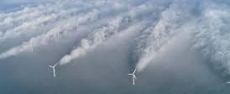
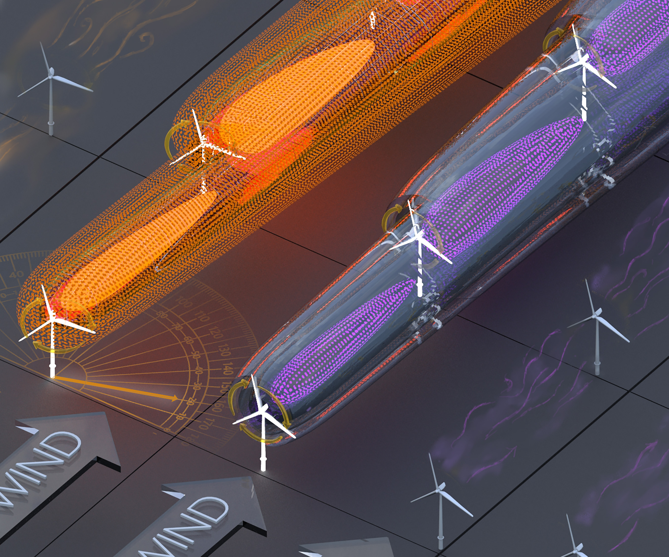
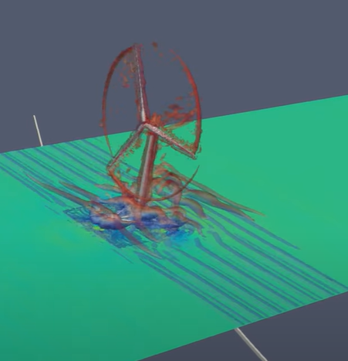
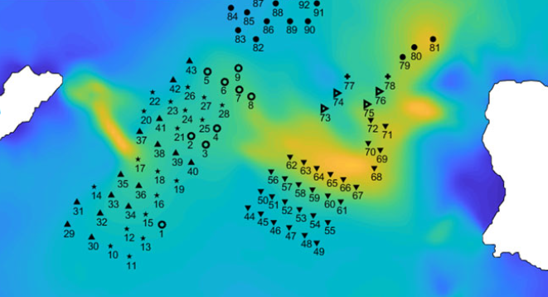
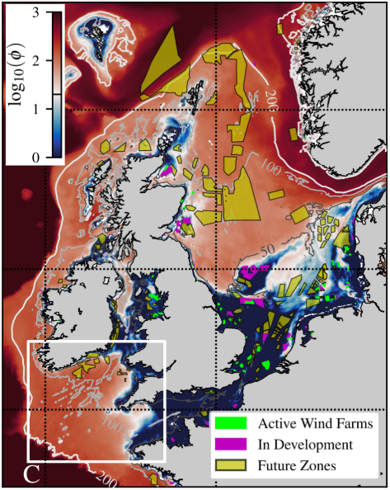
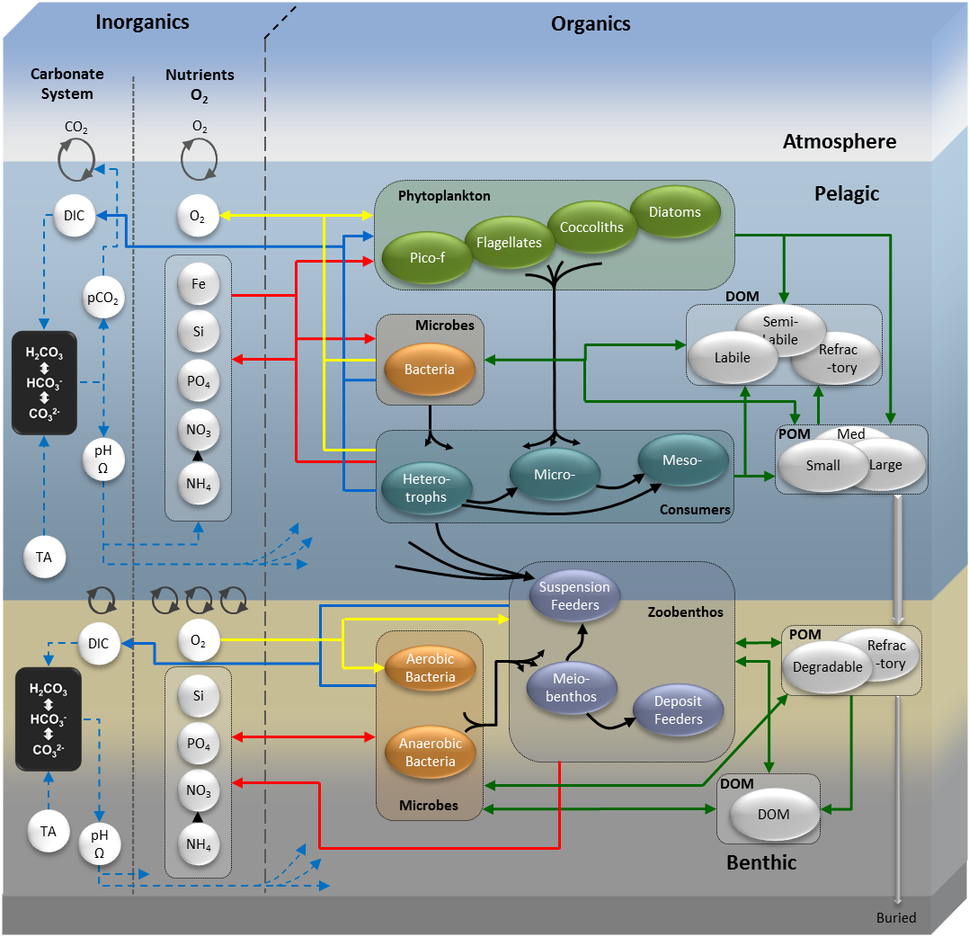
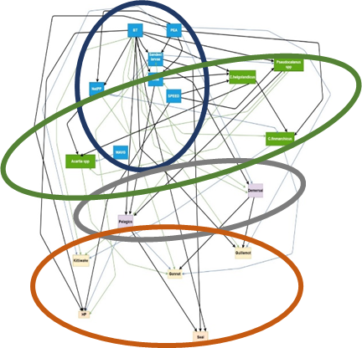
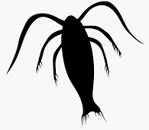
Delivering better models!
Regional scale
WIND
Turbine scale
Farm scale
Shelf and decadal scales
WAVE
CURRENT
Notes:
https://www.youtube.com/watch?v=Dgpmdm9ONpE
https://royalsocietypublishing.org/doi/full/10.1098/rsta.2019.0502

Slide 7
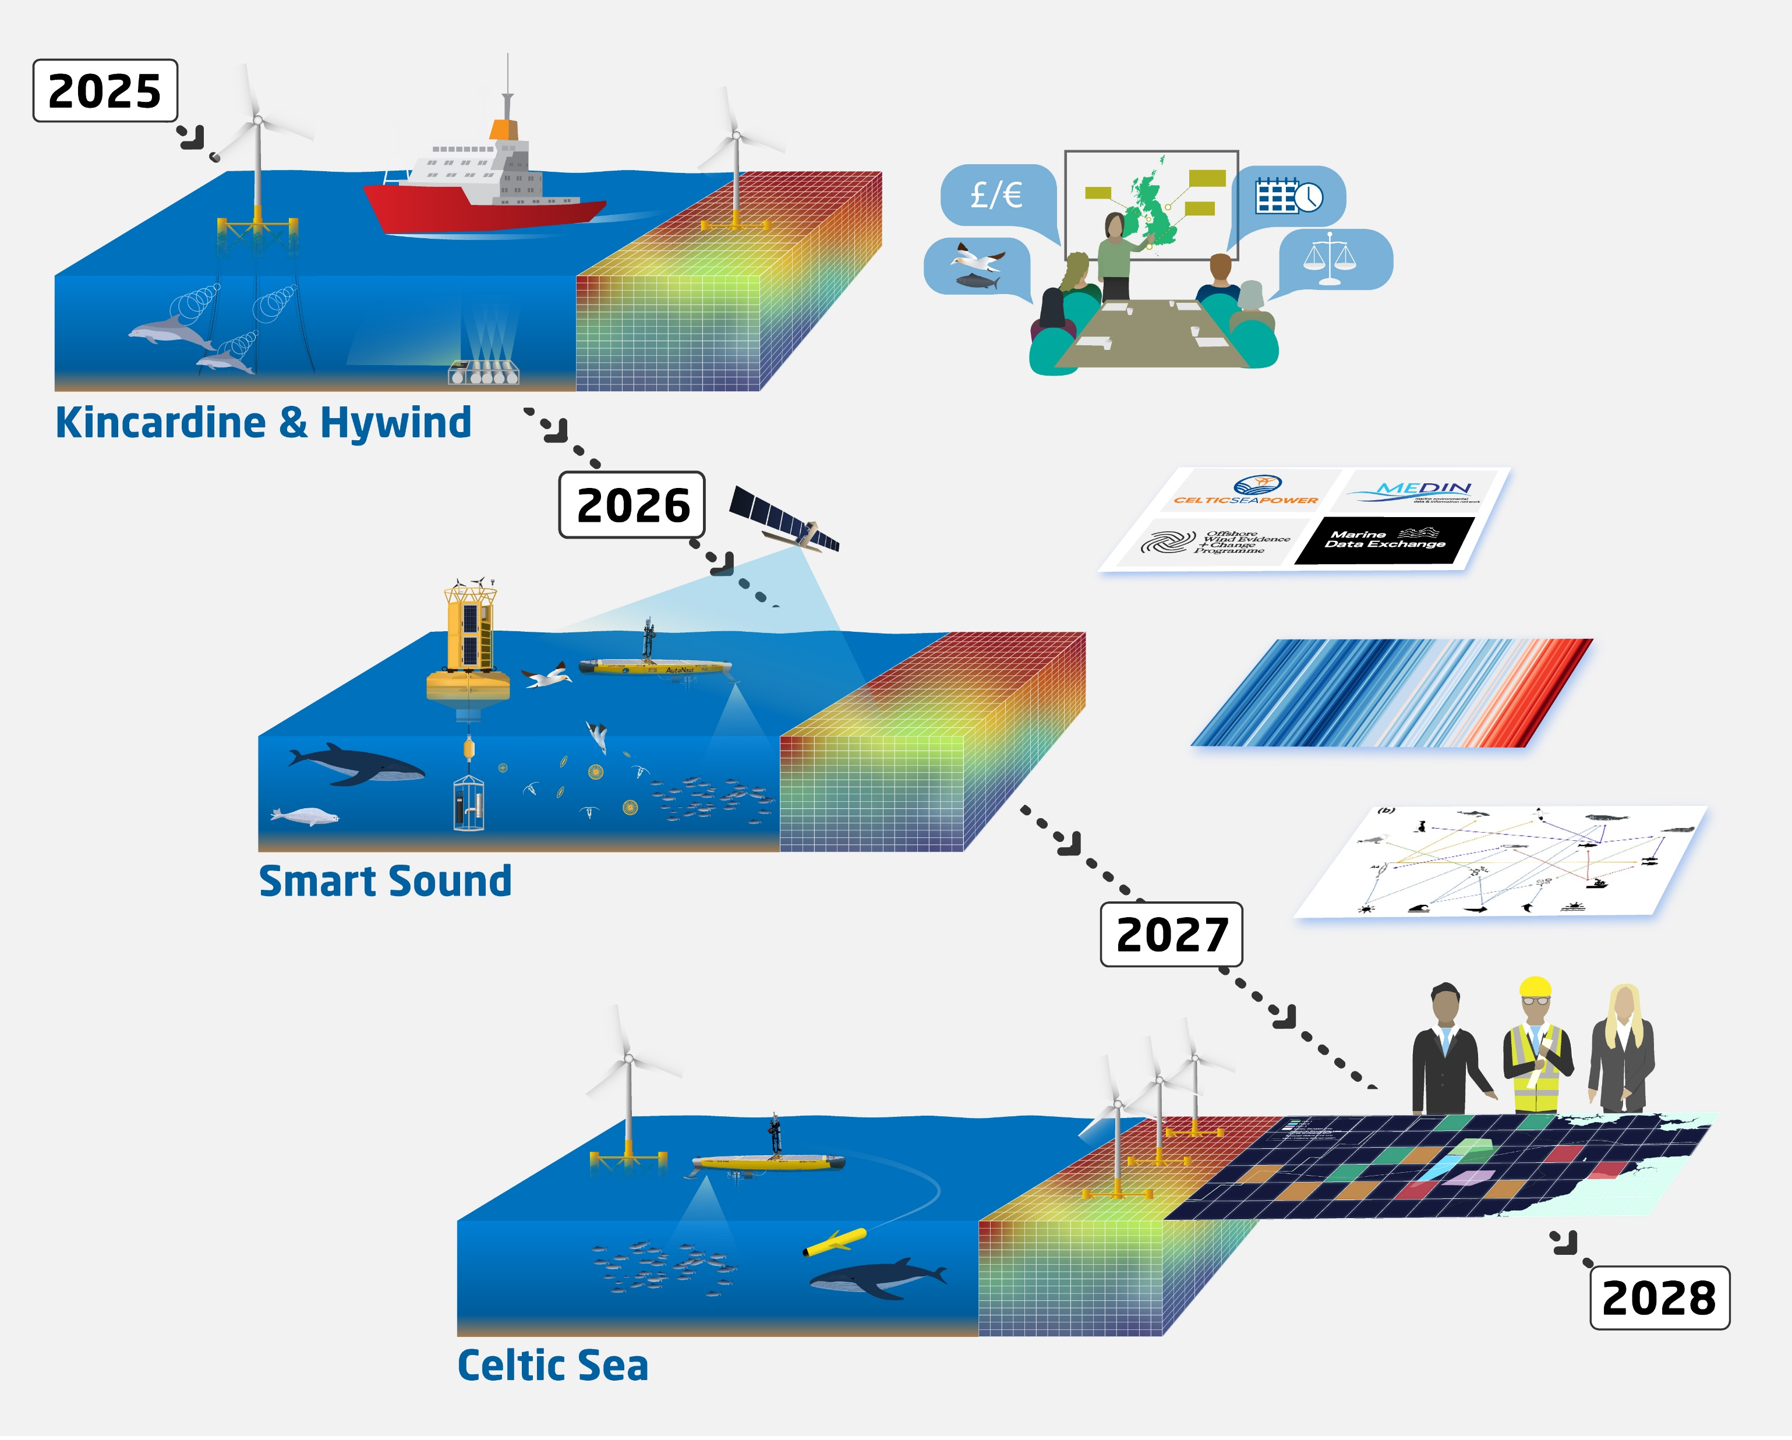
Innovative monitoring, working in partnership to provide better evidence

Slide 8
WP5: Towards sustainable FLOW (Decision Support Tools)
“… to enhance the capabilities of planners, spatial managers and industry, to access evidence guiding sustainable development of FLOW”
PELAgIO
ORIES
Dynamic Bayesian Network Model for population trends
AI assisted marine spatial prioritization
Identifies currently unknown drivers of system dynamics to inform future management & help harness benefits.
Explores our best available evidence
to inform sustainable spatial design that minimizes impacts & harness benefits e.g. potential for net gain
Whole system responses to FLOW

Slide 9
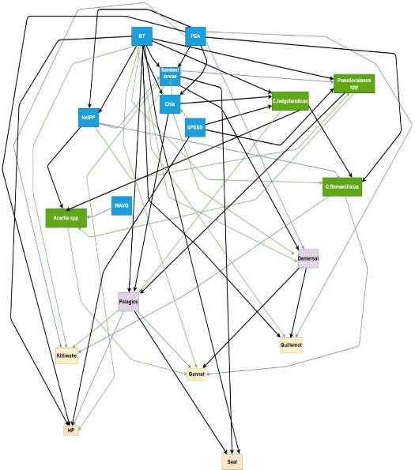
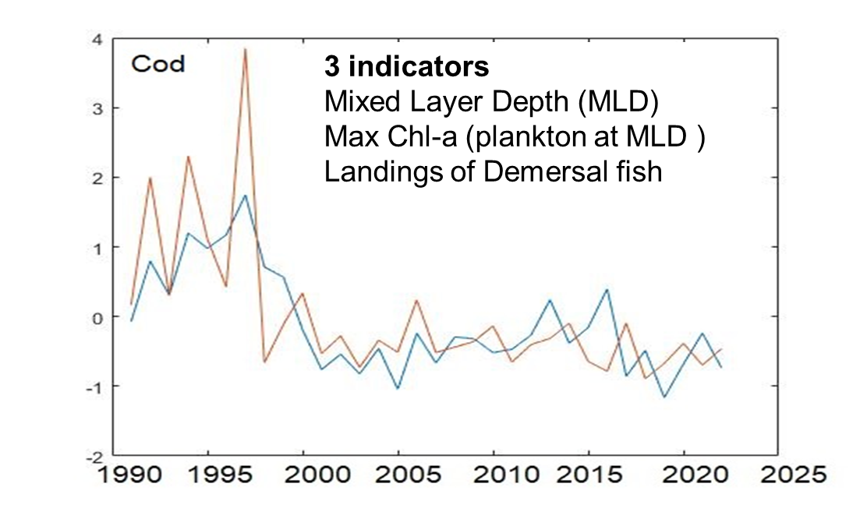
WP5: Towards sustainable FLOW (Decision Support Tools)
“… to enhance the capabilities of planners, spatial managers and industry, to access evidence guiding sustainable development of FLOW”
T5.1, T5.2
WP2: FLOW modelling
WP3: In situ FLOW pelagic monitoring
WP4 & 1: In situ FLOW fish, bird and mammal behaviour
T5.2: Stakeholder workshop: co-existence and co-location outcomes in relation to commercial fisheries and
FLOW to identify policy recommendations.
T5.1: Indicators: population projections (reflecting cumulative effects) to inform assessments of marine net gain.
Dynamic Bayesian Network Model

Slide 10
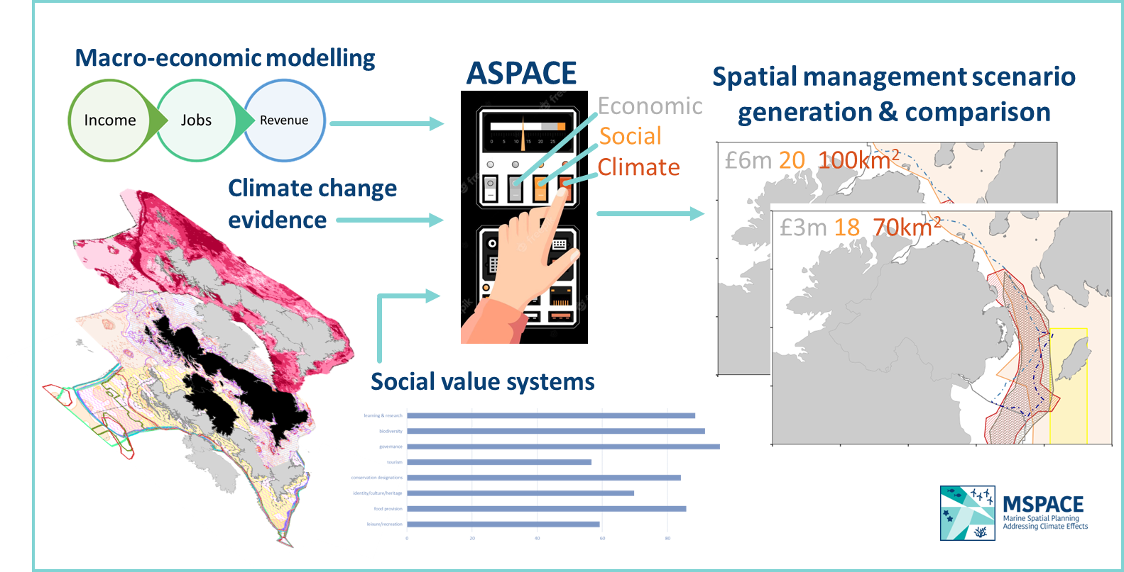
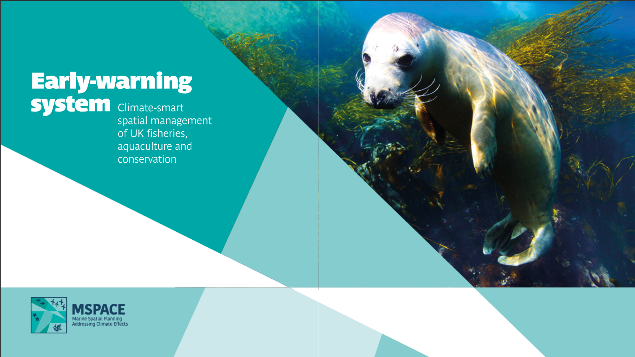
WP5: Towards sustainable FLOW (Decision Support Tools)
“… to enhance the capabilities of planners, spatial managers and industry, to access evidence guiding sustainable development of FLOW”
T5.3
ORIES database
WP2: FLOW modelling
WP3: In situ FLOW pelagic monitoring
Co-developed (ASPACE workshop) Celtic Sea
spatial management scenarios,
optimising placement of FLOW toward policy recommendations:
i) ecosystem change (WP2-4)
ii) climate change;
iii) effects of FLOW on regional ecosystem
Services & blue economy;
iv) social values placed on marine space.
Scenario scores: climate resilience, economic
viability & social acceptance.
WP4 & 1: In situ FLOW fish, bird and mammal behaviour
AI assisted marine spatial prioritization software

Slide 11
Engineering and Ocean Modelling Communities
FLOW turbine scale model data
FLOW farm scale model data
FLOW regional scale model data
REP model outputs
Data flow
Data flow
Data flow
A modular and standards-based data architecture;
core to enabling the exchange of information between project communities
Data flow
Data flow
Data flow
Data flow
Data flow
Ecosystem Monitoring Communities
Fish and Higher Trophic Layer Communities
?
Decision Support Communities
Plankton imaging data
Glider data
WCO L4 data
USV data
eDNA data

Slide 20
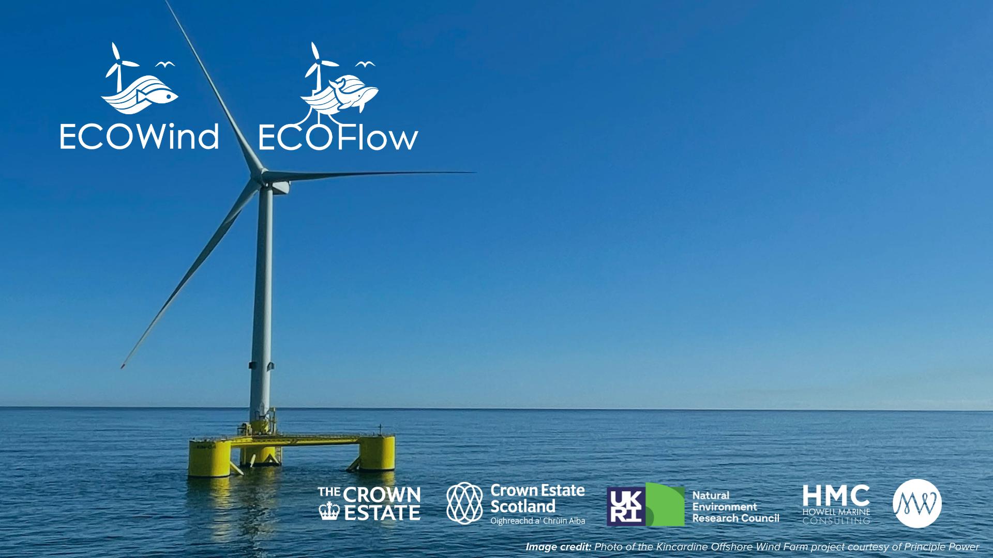

Slide 21
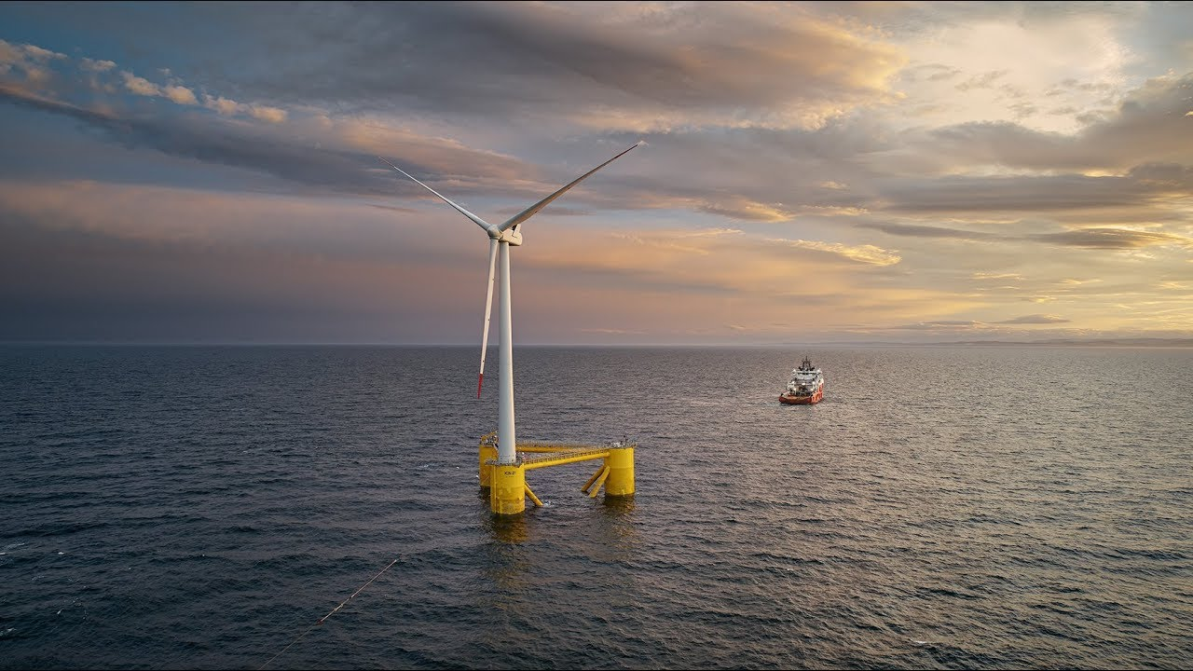
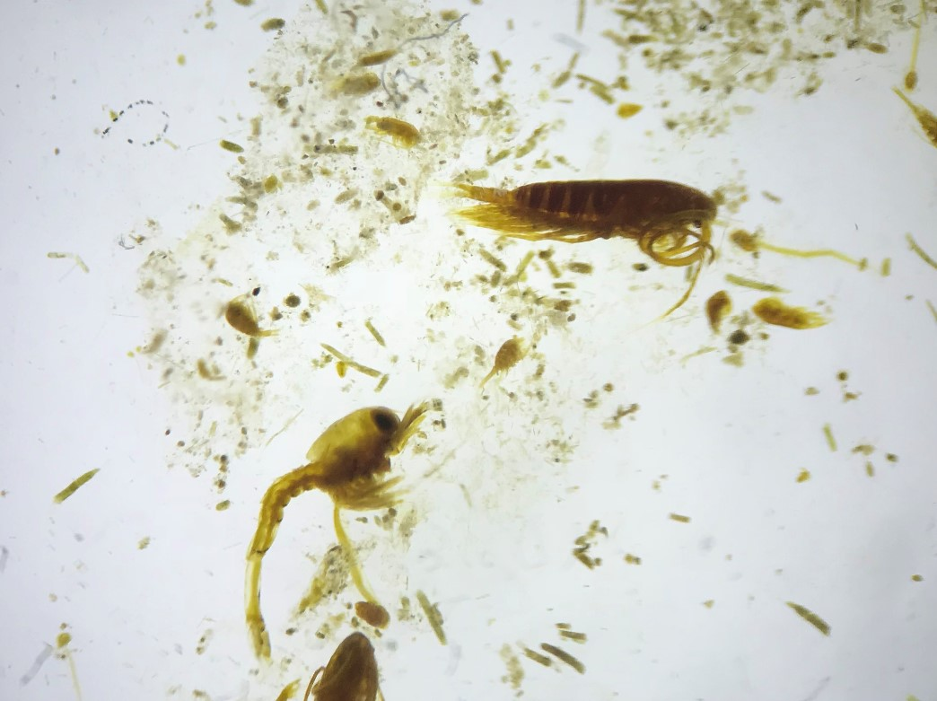
NERC £2.66 Million [2024-2027]
Enabling Sustainable Wind Energy Expansion in Seasonally Stratified Seas (eSWEETS³)
How might ocean biogeochemistry respond to mixing around floating offshore wind farms?
PI: Jonathan Sharples
Universities of Liverpool, Southampton, Plymouth, Bangor, Aberdeen, Hull, East Anglia, SAMS, National Oceanography Centre and Marine Scotland Science

Slide 22
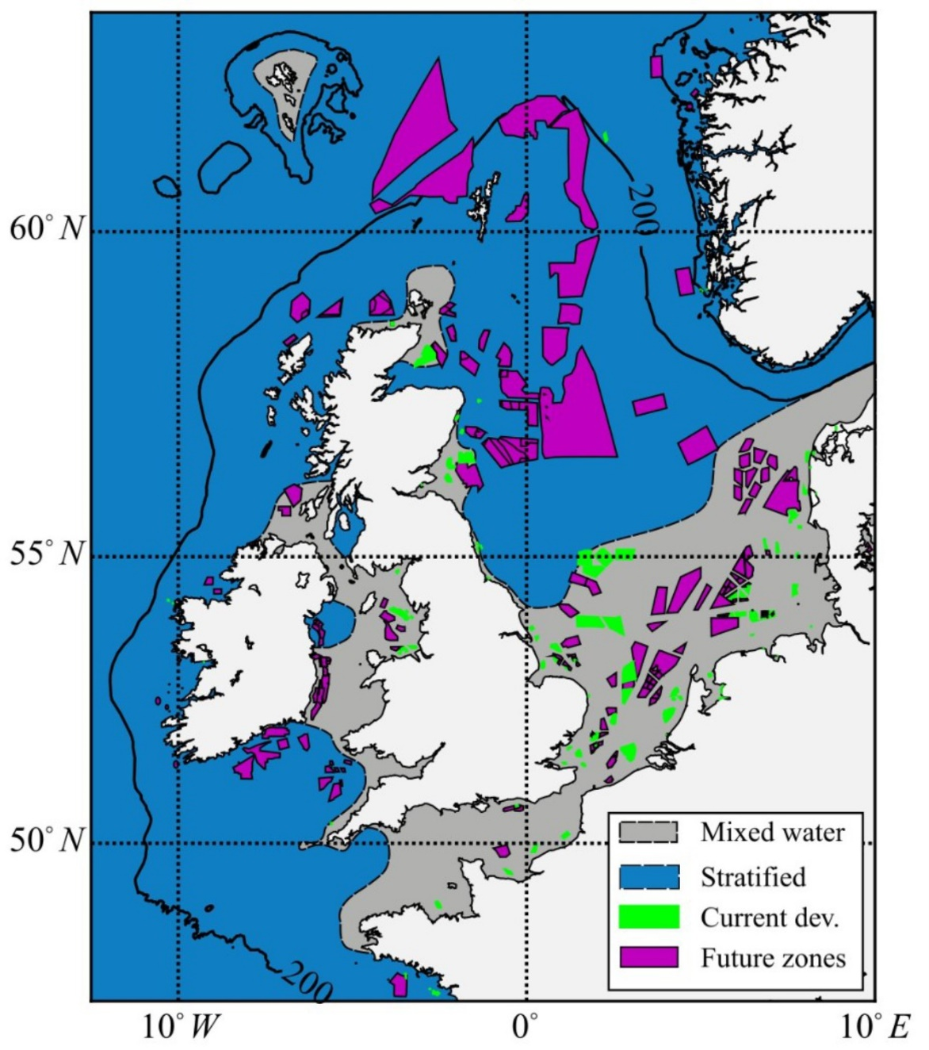
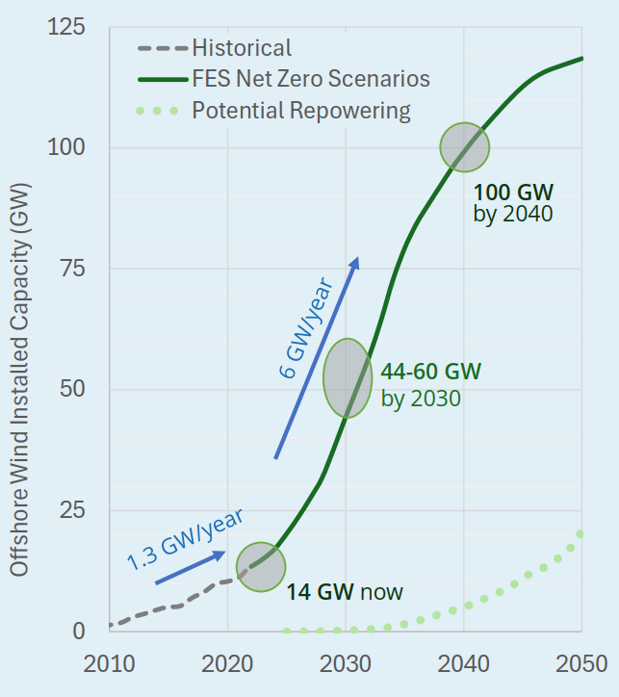
2040: Offshore Wind Projections
Existing wind farms are all in shallow, mixed water, using fixed foundations.
Beyond 2030, floating offshore wind, in areas of deep water, is likely to make up > 50% of OW projects.
These deeper waters have very different oceanographic characteristics.
Supergen, 2024

Slide 23
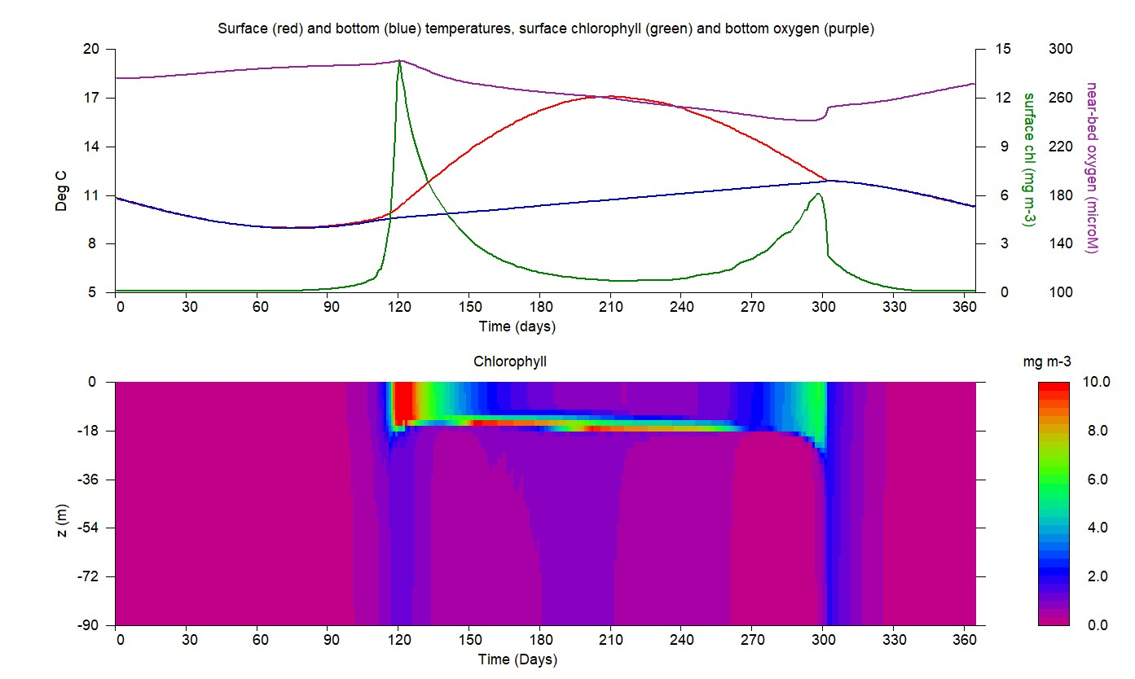
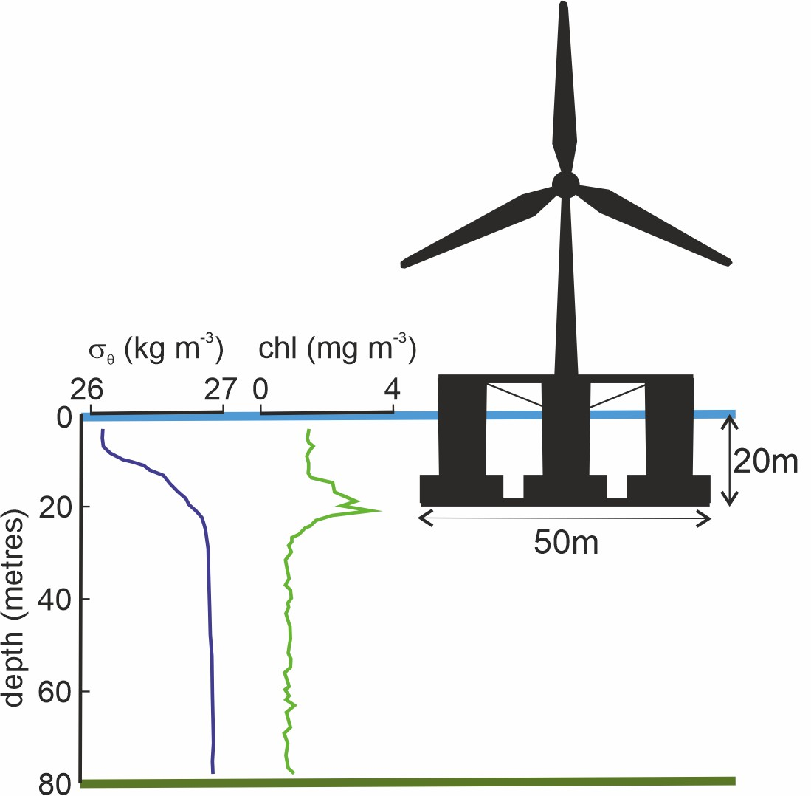
Deep water seasonal cycle:
no nutrients
spring
bloom
subsurface
layer of plankton
lots of nutrients
autumn
bloom
high nutrient concentrations

Slide 24
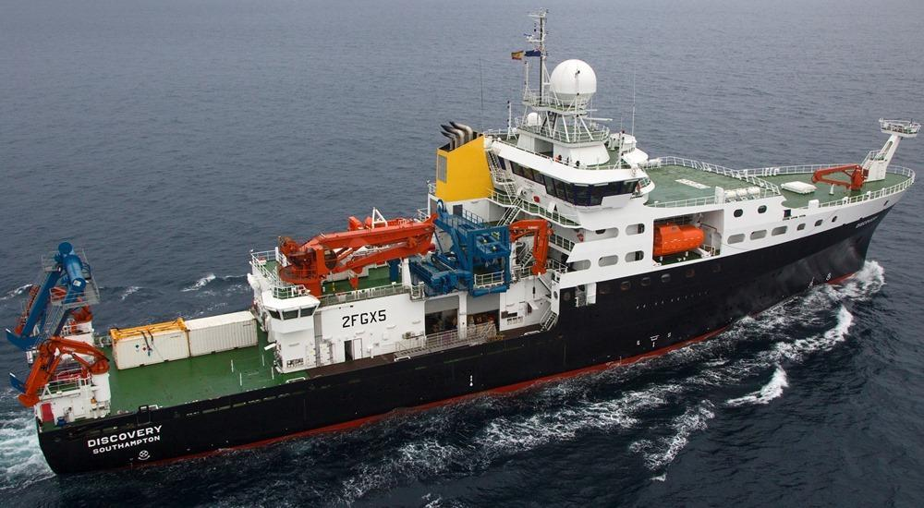
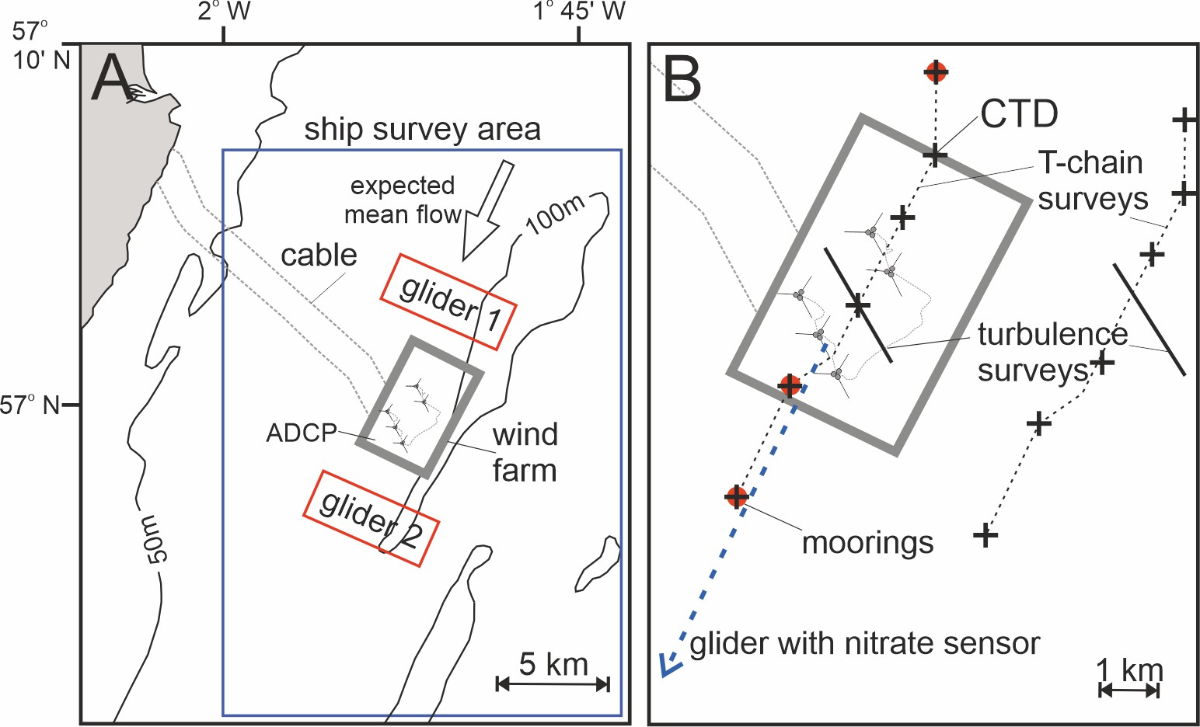
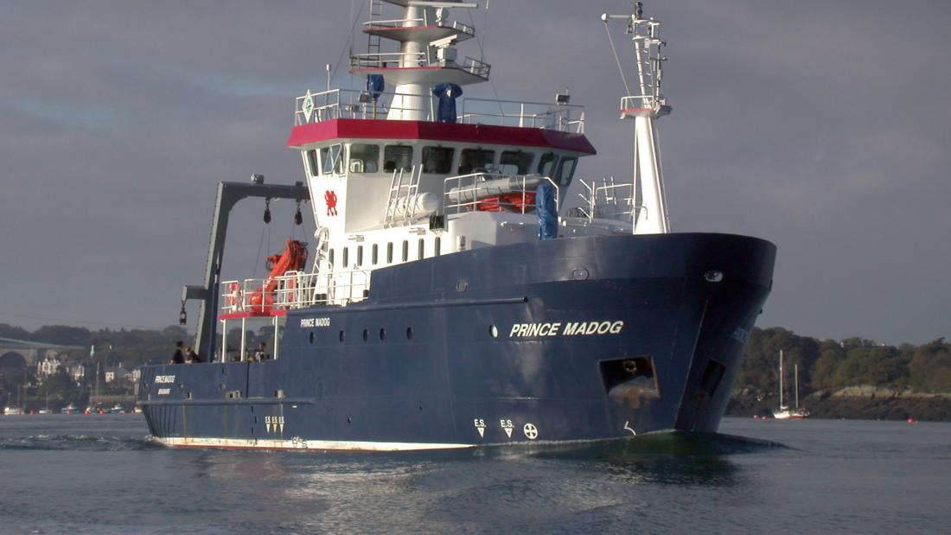
The eSWEETS³ project:
Fieldwork: 2 ships, summer 2025
jons@liverpool.ac.uk

Slide 25
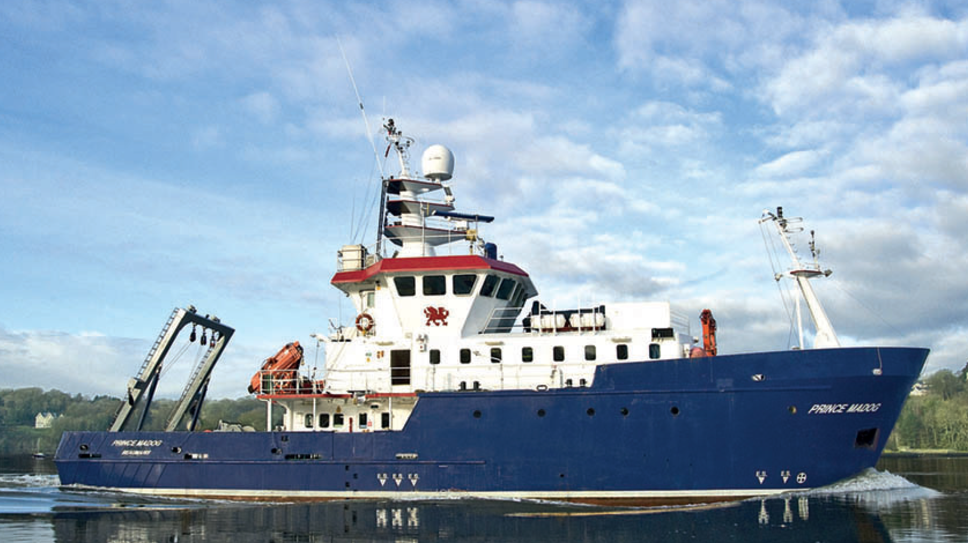
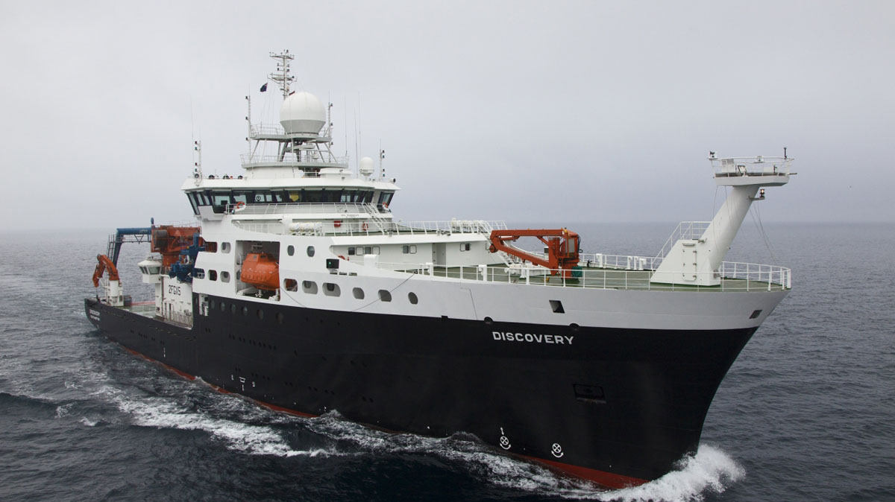
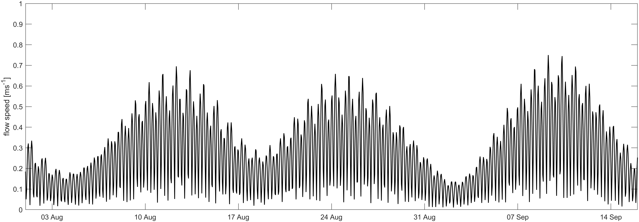
eSWEETS³ Cruise timelines 2025
R.V. Prince Madog
transit
transit
transit
R.R.S. Discovery
transit
Tidal current forecasts used to target strongest flows for wake measurements

Slide 26
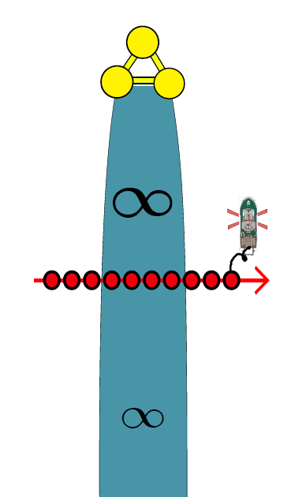
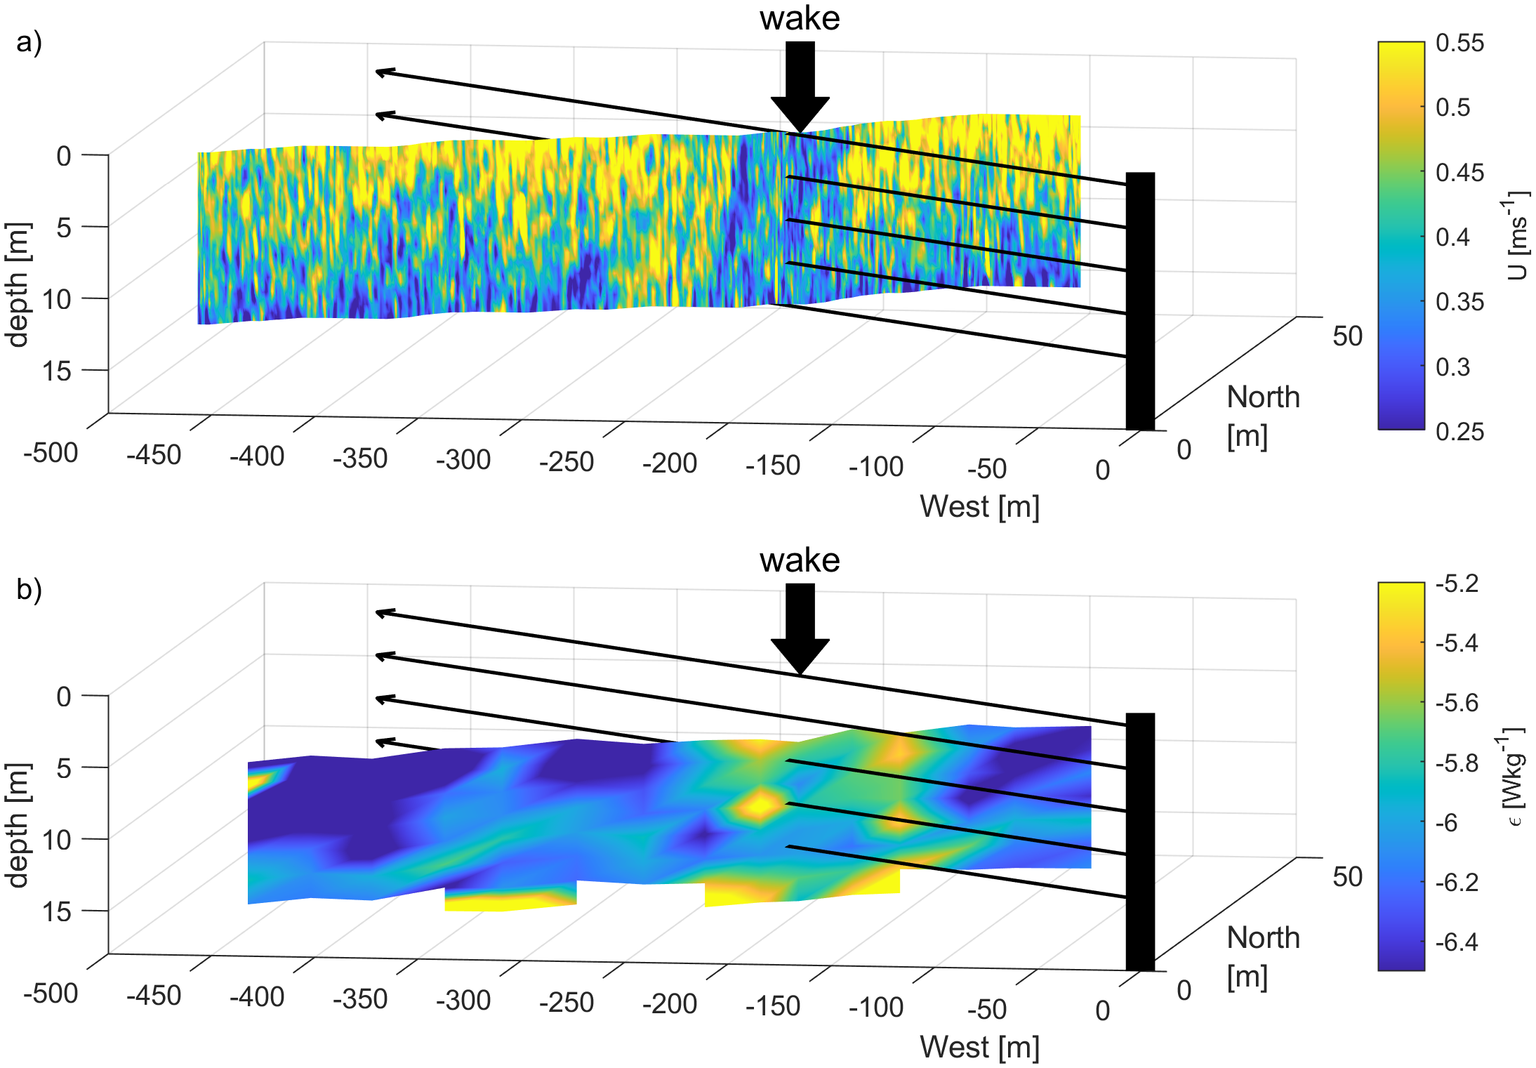
1. Turbulence Profiling
Example turbulence profile data Rhyl Flats wind farm - Irish Sea - 2019
Turbulence profiling >100m downstream of turbines
Deployed from ship stern to 50m depth
Holding distance downstream
Transiting across the wake yo-yo profiling
wake

Slide 27
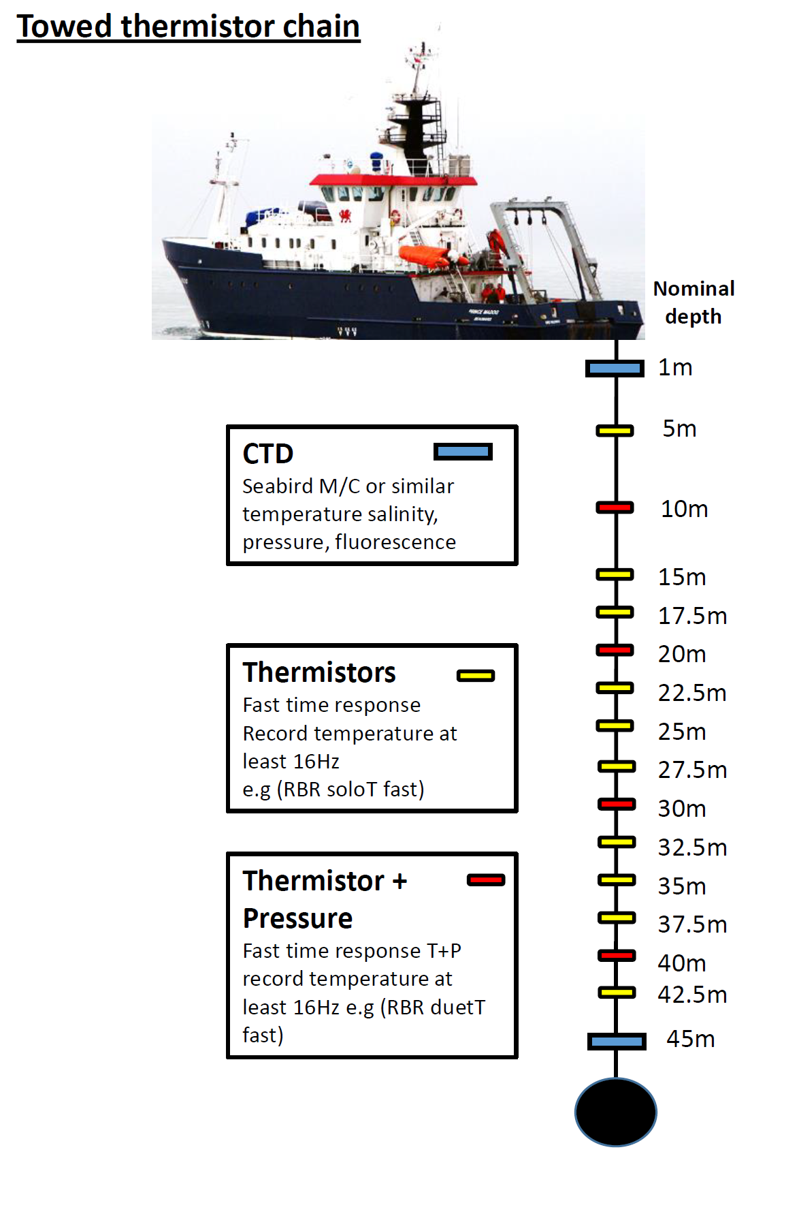
2. Towed Thermistor Chain
Towed Chain Transects
Towing speed 3-4kts
Transects across the wakes
100/200/500m downstream
Southern + Northern transects
Never closer than 100m
Always downstream of turbines
Weighted chain hangs vertically to reach ~50m water depth
Instrumented with temperature and pressure sensors to map the impact of turbulence on stratification
Numerical simulation of measured temperature and flow speed

Slide 28
3. Glider monitoring
6-month operation monitoring north (‘upstream’) and south (‘downstream’) of the array
May 2025: Two Slocum gliders deployed from MRV Scotia
August 2025: Slocum gliders replaced with two more from RSS Discovery. Additional Seaglider deployed for 3 weeks.
October 2025: Slocum gliders recovered from a Marine Scotland vessel
All measuring temperature, salinity, dissolved oxygen, chlorophyll, light, plus nitrate on the Seaglider
~15-minute dives to 80 m (~200 m distance)
Gliders target areas always >1 tidal excursion away from the turbine array.
10 km
‘Upstream’
5 km
‘Downstream’
5 km
10 km
Notes:
Ballpark 15,000 dives in each region over 6 months.

Slide 29
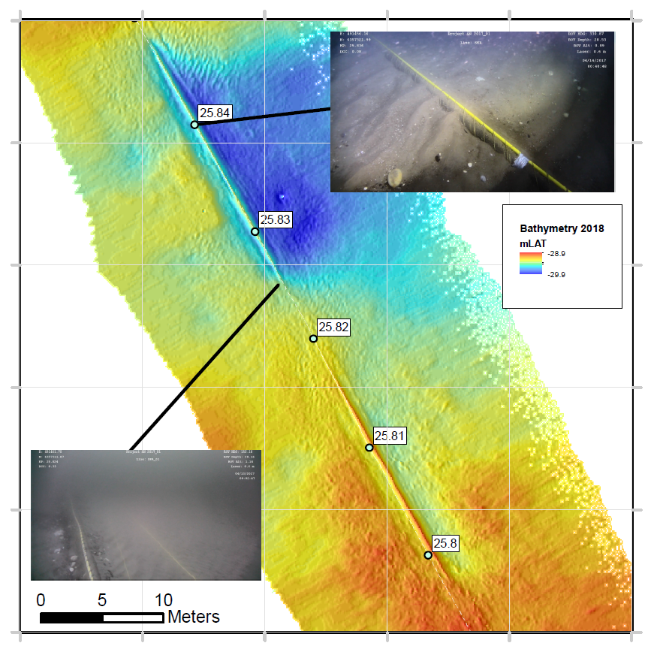
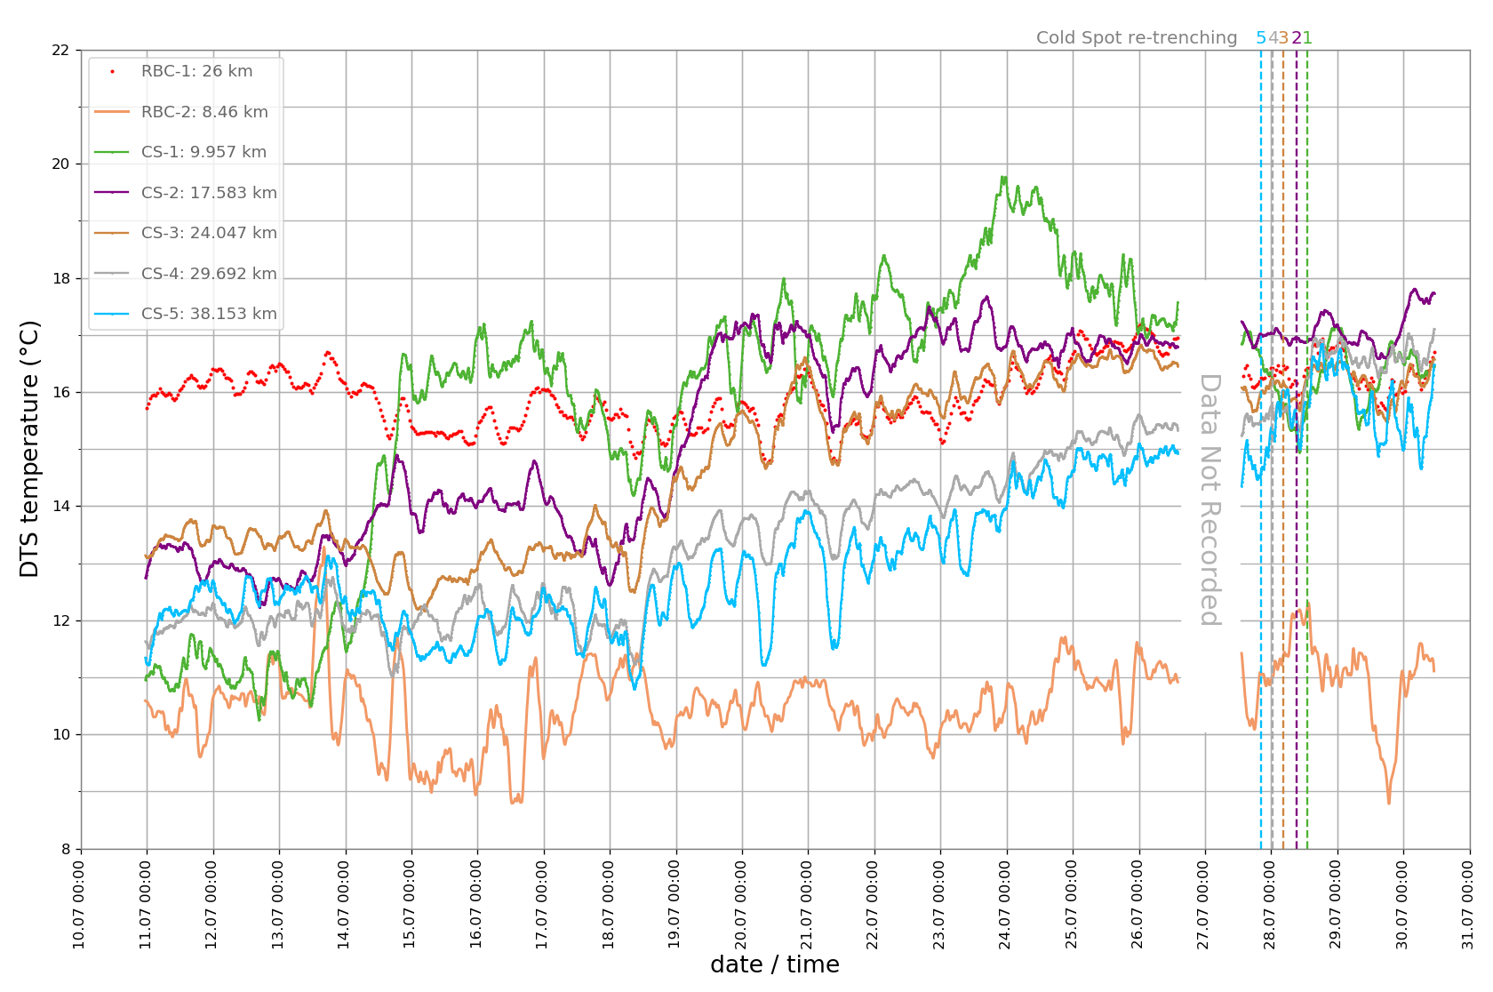
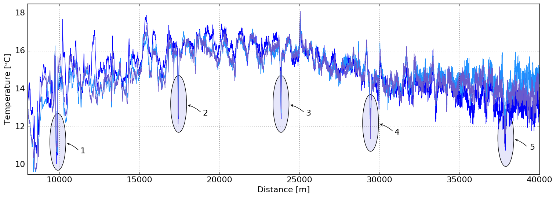
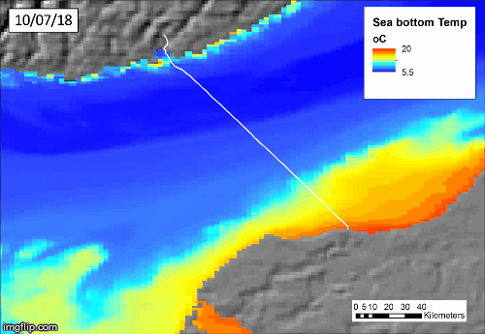
Interpretation of DTS Data
Coastal Temperature
High
Buried Stable
Cable
Re-buried Cables
Periods Rapid Temperature Transition
Exposed Cables
Erdmann, Dix et al, 2019
UK Met Office’s, 1.5 km, FOAM Shelf Seas Atlantic Margin Model (AMM15) –Daily Data

Slide 30
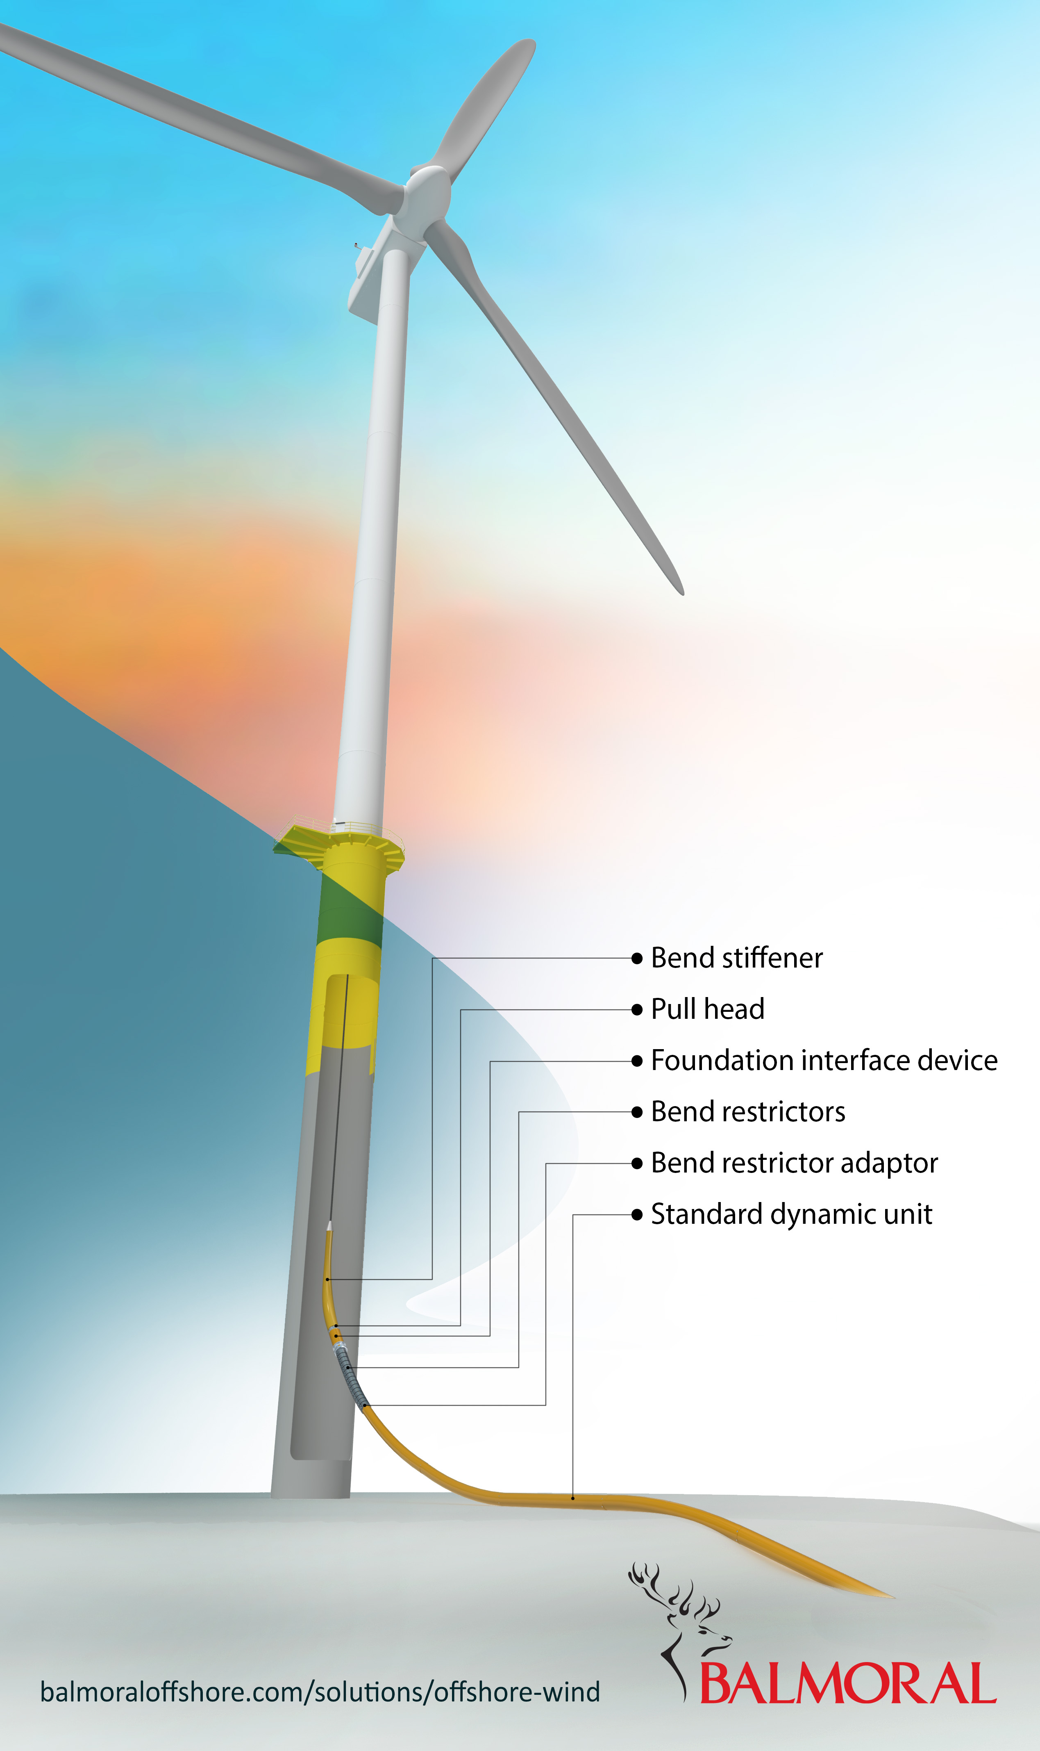
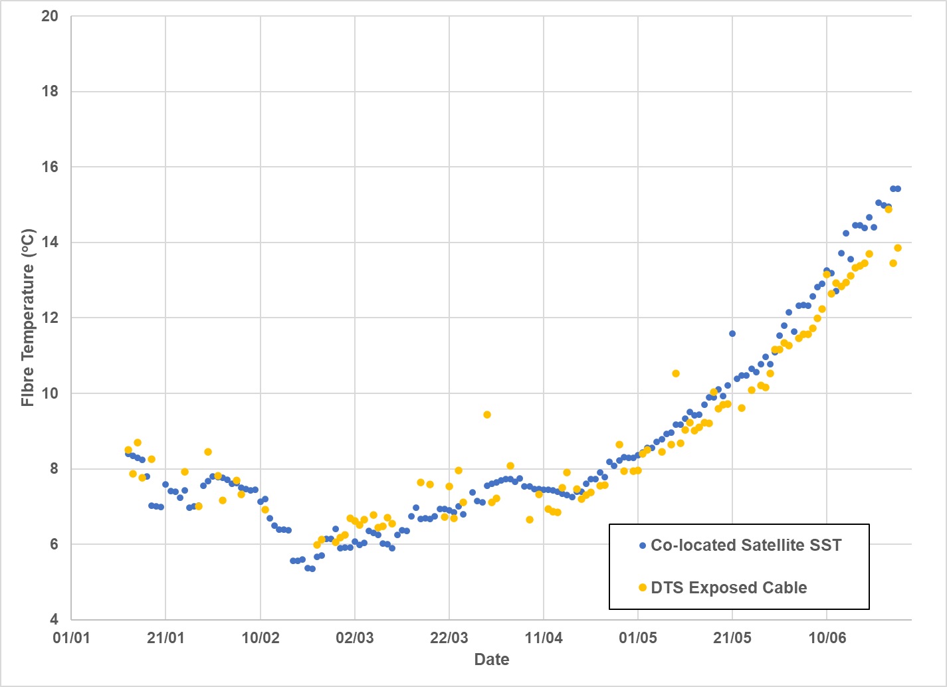
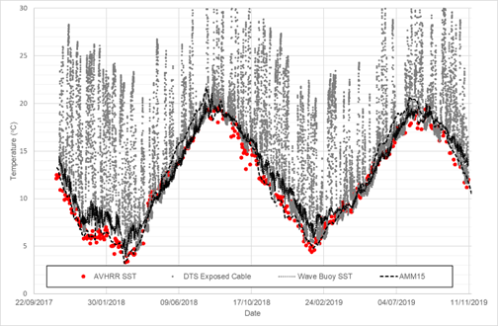
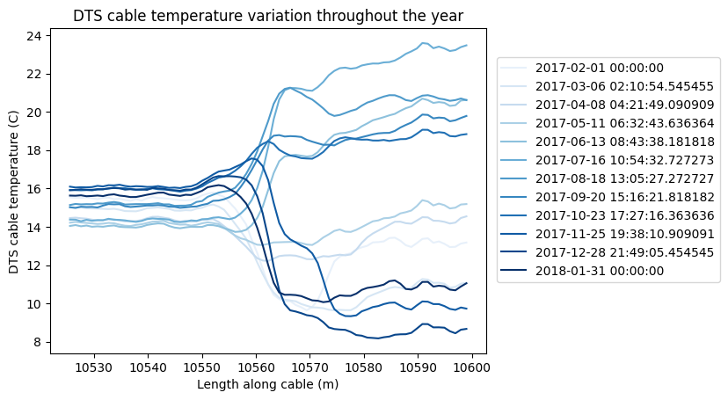
DTS Profiles from Inter-array Cables
Windfarm in perennial well mixed zone – good correspondence with DTS data, local wave buoy measuring SST and AMM15 model
Single-time step DTS
MAE = 0.18°C; MBE = 0.16°C; RMSE = 0.65°C (N = 112)
Entry to J-Tube
12x Single-time
step DTS – 1 per month
Buried
B
Exposed
Dix et al, 2023
Notes:
Shows buried and unburied, and relative change of DTS depending on burial throughout the year

Slide 31
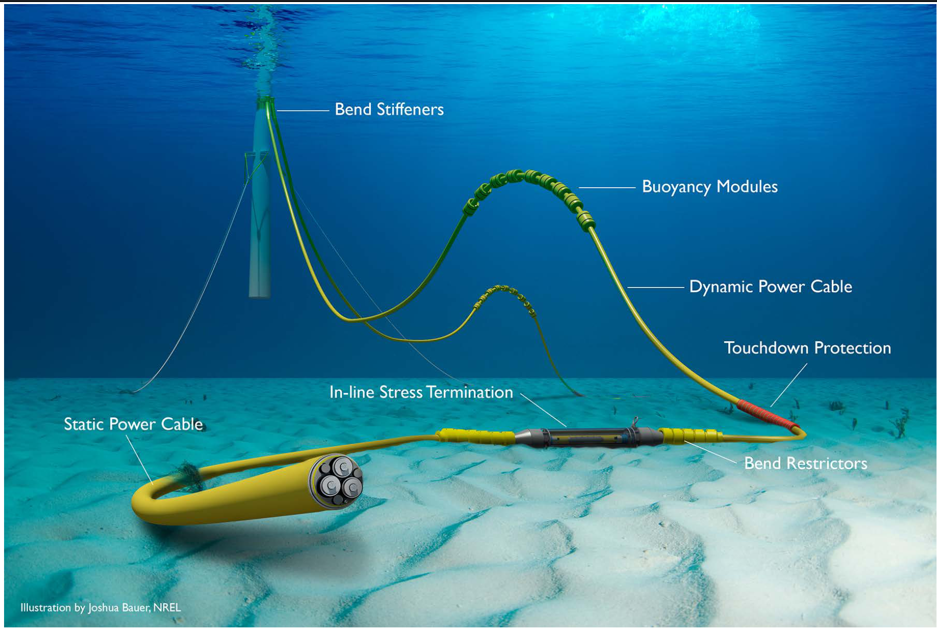
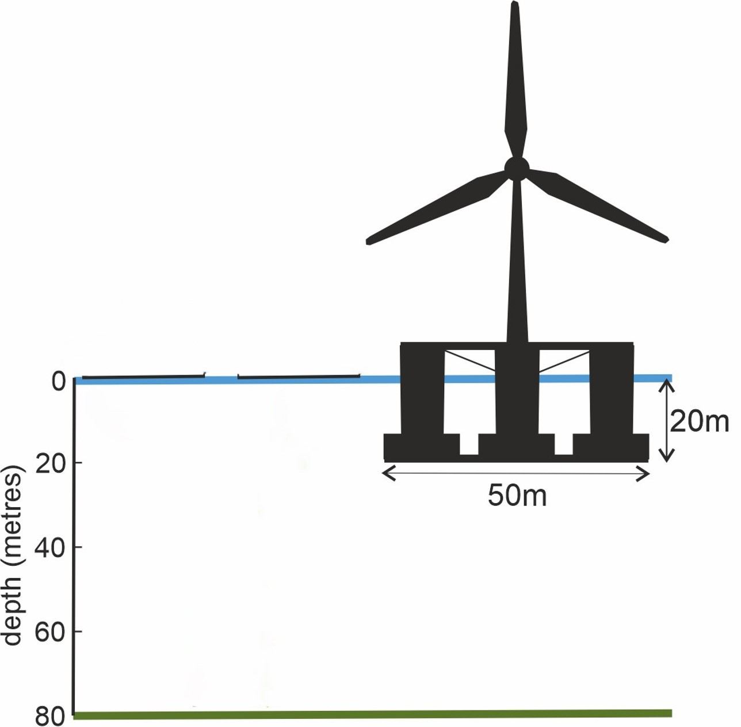
4. DTS in eSWEETS³ – cost-effective monitoring of bottom water
Baring-Gould, NREL, 2014

Slide 32
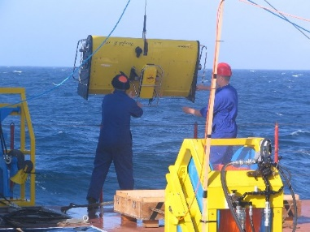
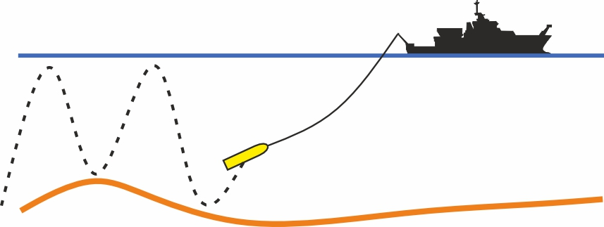
5. The “Far” field
A lot of Scanfish surveys, up- and down-stream in the mean flow.
2 x moorings (ADCP, T-loggers, bottom water oxygen concentration).
CTD for nutrients, phytoplankton, organic material.
Nets for zooplankton.

Slide 33
6. The really “Far” field
Eventually:
Combine measurements to provide model parameterisation of FLOW effects on turbulent mixing.
Test FLOW biogeochemical responses and impacts from the model compared to observations.
Integrate FLOW impacts on the scale of projected deployments of FLOW.
Large-scale development of DTS monitoring of bottom water temperatures and stratification.

