Slide 2
PELAgIO
ASSESSING THE IMPACT OF OFFSHORE WINDFARMS & CLIMATE CHANGE ON THE OCEAN & BIOGEOCHEMICAL STATE OF THE NORTH SEA
M. De Dominicis¹, R. O’Hara Murray², A. Gallego², J. Jardine¹, W. MacDonald², M. Palmer³, T. Smyth³, J. Wihsgott³, C. Williams1, A. Zampollo^{2,4} & B. Scott⁴
(1) National Oceanography Centre
(2) Scottish Government Marine Directorate
(3) Plymouth Marine Laboratory
(4) University of Aberdeen

Slide 3
Shelf Sea Setting
PELAgIO
Shelf seas cover 7% of the ocean
Up to 30% of productivity at the bottom of the food chain
Stratification
Simpson and Sharples (2012)
Notes:
To date wind farms have been installed in permanently mixed regions on monopiles or jacket foundations. The next phase of offshore wind development will be in deeper waters that undergo periodic or seasonal stratification, and floating foundations are likely to be used.

Slide 4
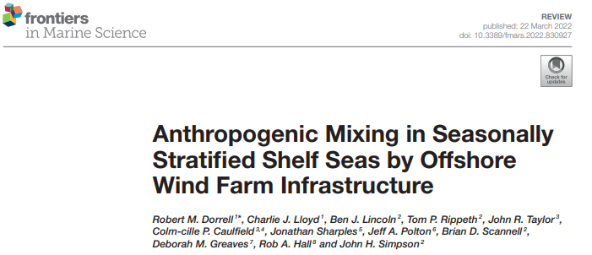
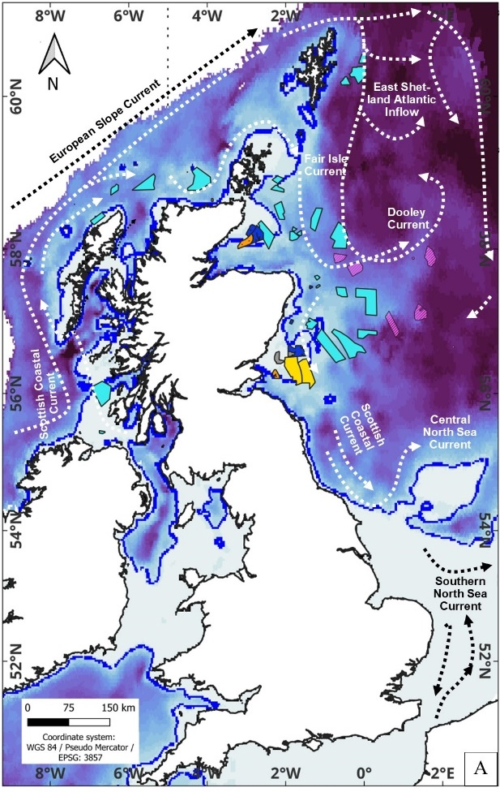
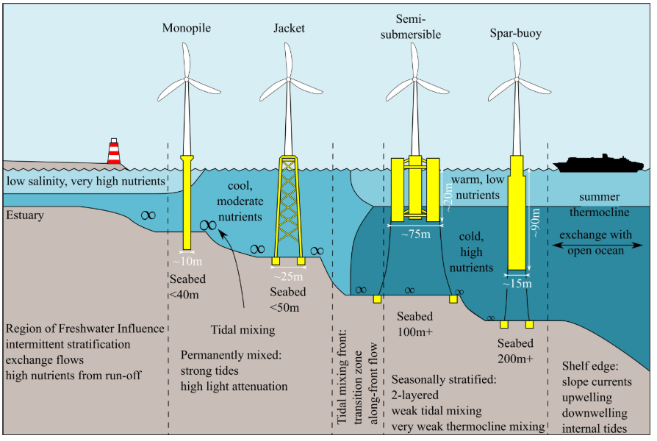
Offshore wind farms could change mixing
Notes:
Offshore wind development is now in deeper waters on the continental shelf (e.g. ScotWind and INTOG). Up to now they’ve mainly been deployed in shallower waters, closer to shore, and in well mixed areas. Deeper areas are likely to be seasonally stratified and floating foundations are likely to be used.
These figures are from a recent paper that suggests offshore wind infrastructure is likely to enhance mixing such that in crucial areas, such as front and stratified regions, the timing, strength and extent of stratification could change. This effect would also likely depend on the type of foundations being used.

Slide 5
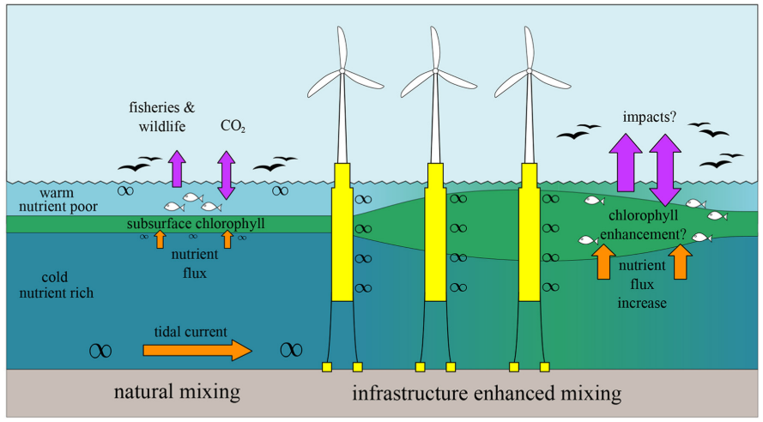
Mixing controls stratification
PELAgIO
Wind farms can change mixing:
Structures
Wind speed deficit / acceleration
Stratification occurs intermittently and seasonally
Extent, location and timing of stratification could change
This could lead to changes in nutrient pathways and ecosystem functioning
Changing behaviours of fish and predators
Modified or redistributed mixing due to changes in wind speeds
Notes:
So, offshore wind farms could change mixing but Mixing controls stratification. There are two broad mechanisms for changing vertical mixing in the water column: structures and the associated drag and turbulence and changes in the wind field

Slide 6
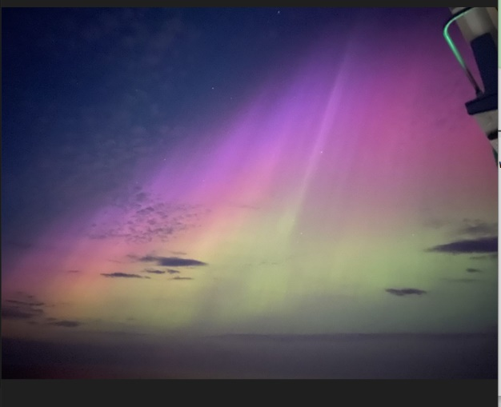
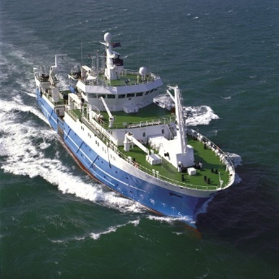
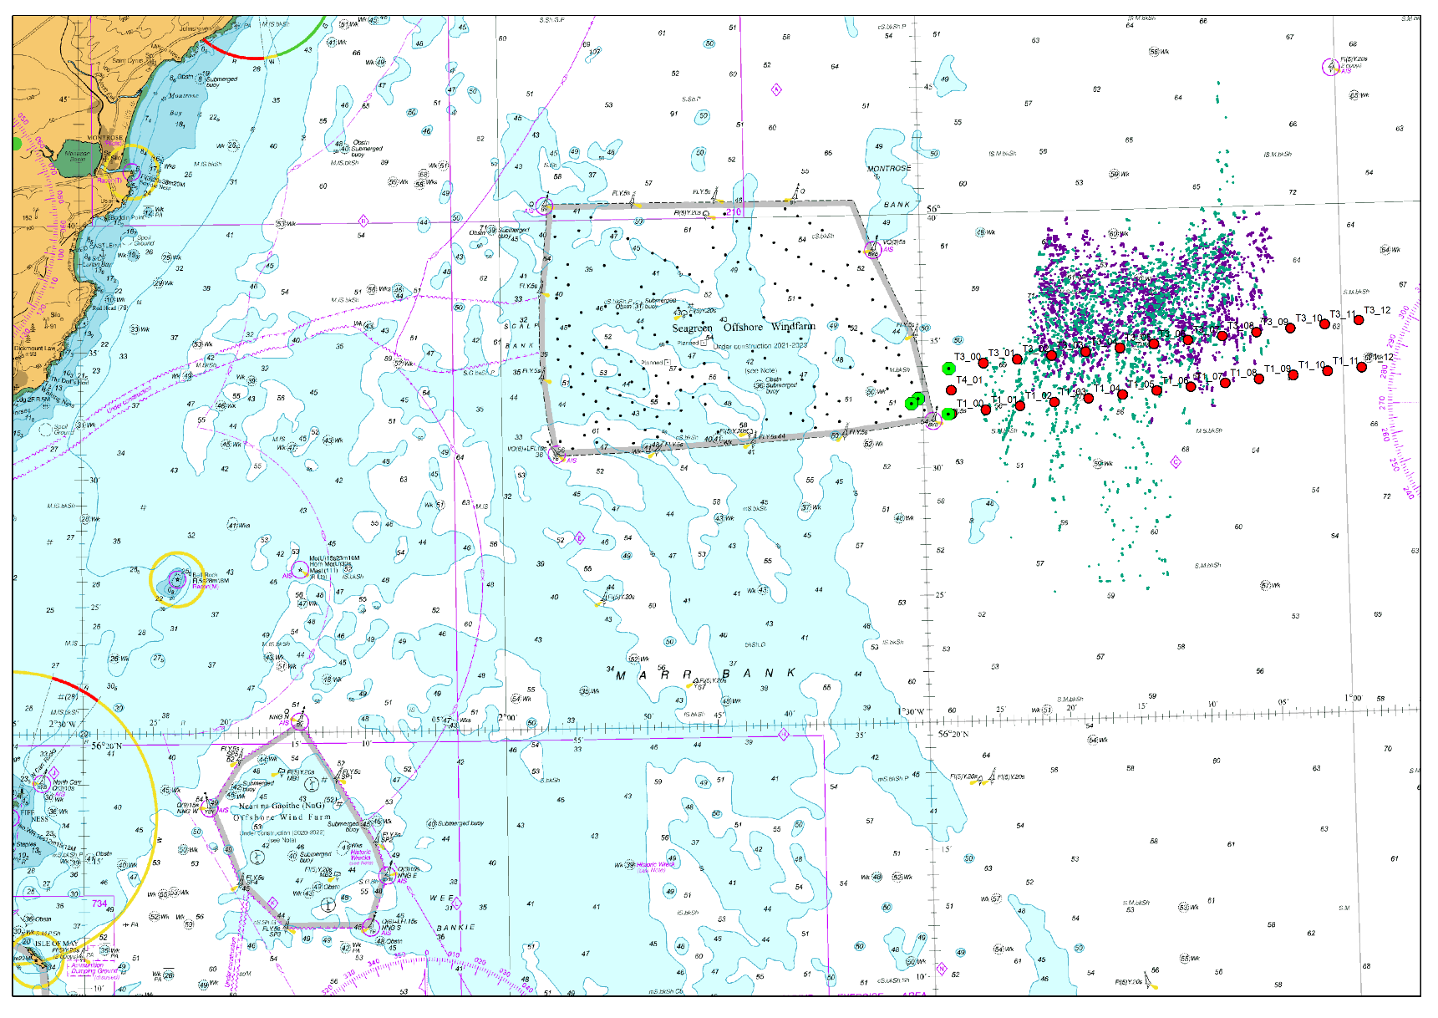
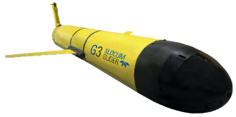
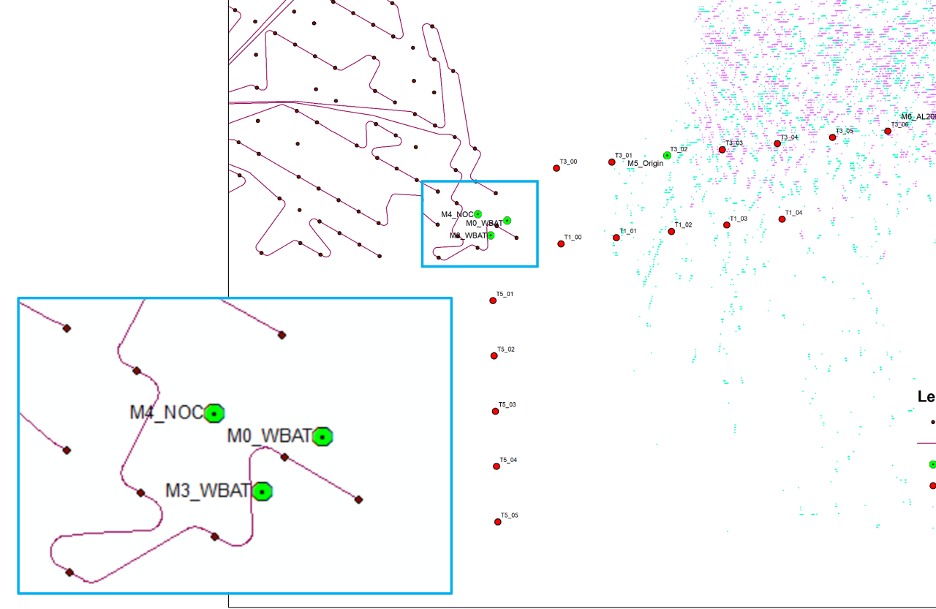
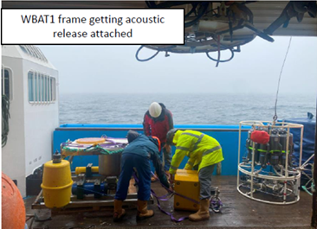
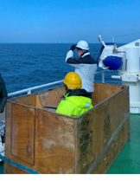
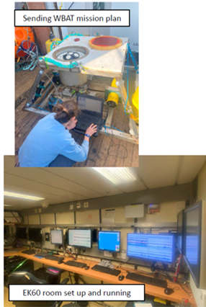
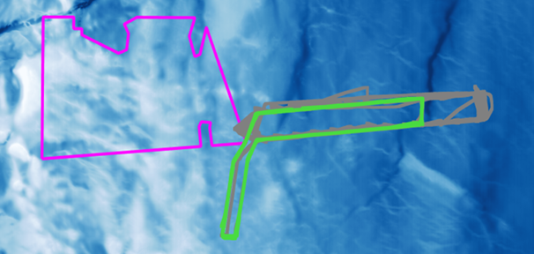
PELAgIO: WP1 fieldwork 2023 and 2024
PELAgIO
Notes:
Fieldwork conducted over two cruises in May and Sep 2023 with Gliders undulating up and down through the water column from late April

Slide 7
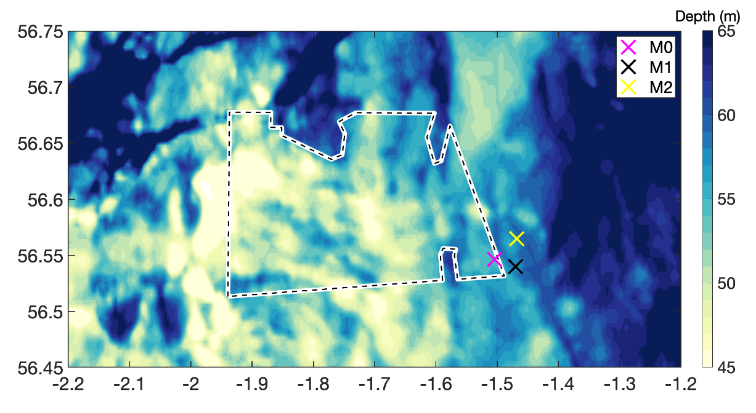
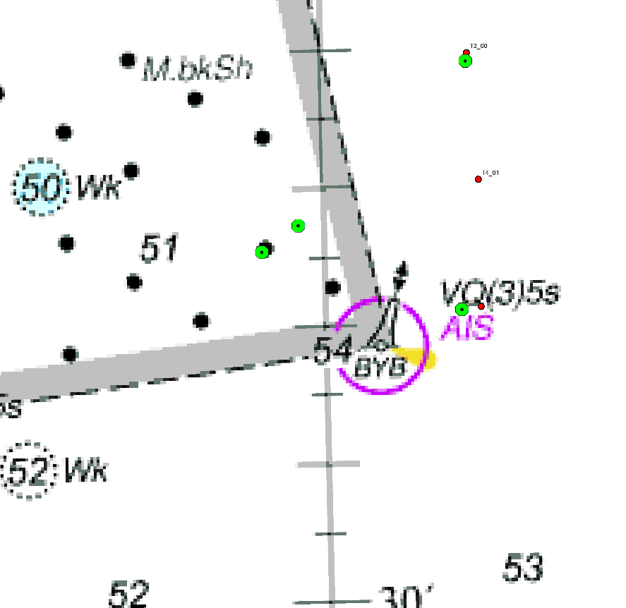
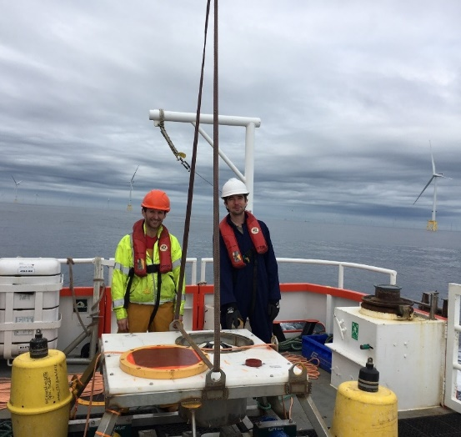
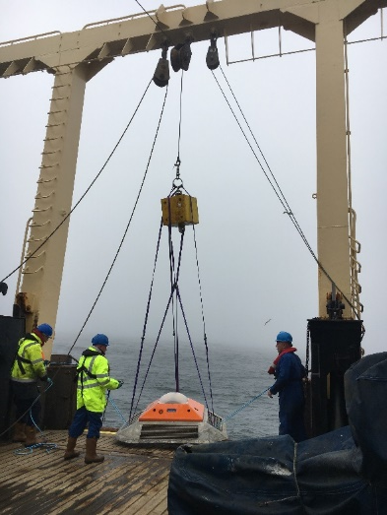
WP1 local scales: Mooring observations 2023
Local scale
Regional scale
PELAgIO
Mooring | N29 turbine | M0 | M2 | M1
Distance to OWF | 50 m | ~ 500 m | ~ 1 km | ~ 3 km
Sensors | 500 kHz ADCP Active acoustics Bed Fluorometer & Turbidimeter | 500 kHz ADCP Active acoustics Bed Fluorometer & Turbidimeter | 300 kHz ADCP full depth temperature & salinity chain | 250 kHz ADCP Seabed temperature sensor
Deployment dates | 10 Aug – 10 Dec 2023 | 6 May – 15 Jun 2023 | 6 May – 19 Sep 2023 | 6 May – 19 Sep 2023

Slide 8
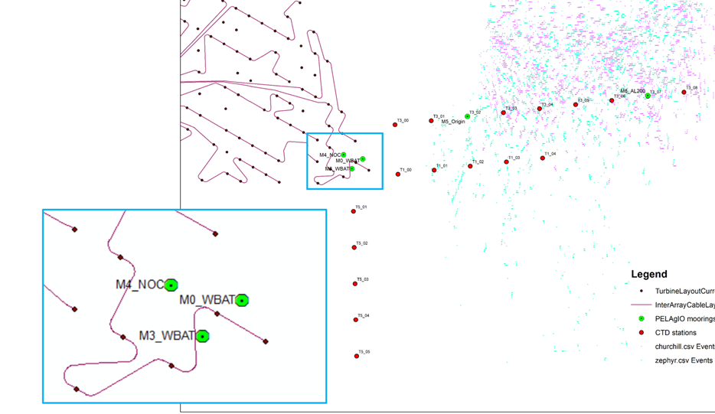
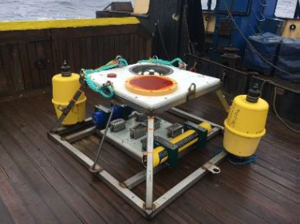
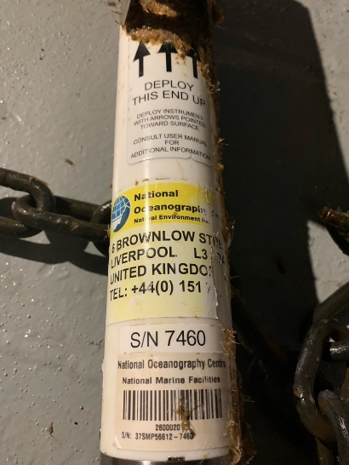
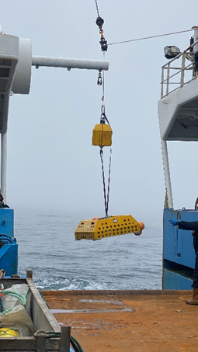
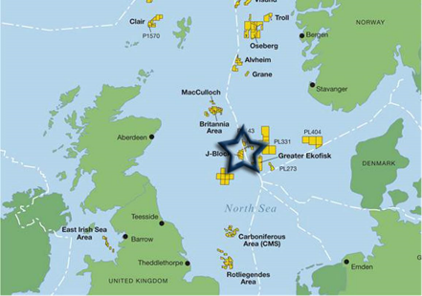
WP1 local scales: Mooring observations 2024
Local scale
Regional scale
PELAgIO
Mooring | M1 | M2 | M3 | M4 | M5
Distance to OWF | 500m (down tide) | 500 m (down wind) | Inside Farm | ~ 3 km | 10 km
Sensors | 500 kHz ADCP Active acoustics Bed Fluorometer & Turbidimeter | 500 kHz ADCP Active acoustics Bed Fluorometer & Turbidimeter | 300 kHz ADCP full depth temperature & salinity chain lost | 250 kHz ADCP Seabed temperature sensor | Sonardyne Origin 600 kHz ADCP
Deployment dates | 3 May to 25 Sept 2024 | 3 May to 25 Sept 2024 | ADCP: 3 May to 25 Sep | 3 May – 25 Sep 2024 | 3 May – 8 Oct ? 2024

Slide 9
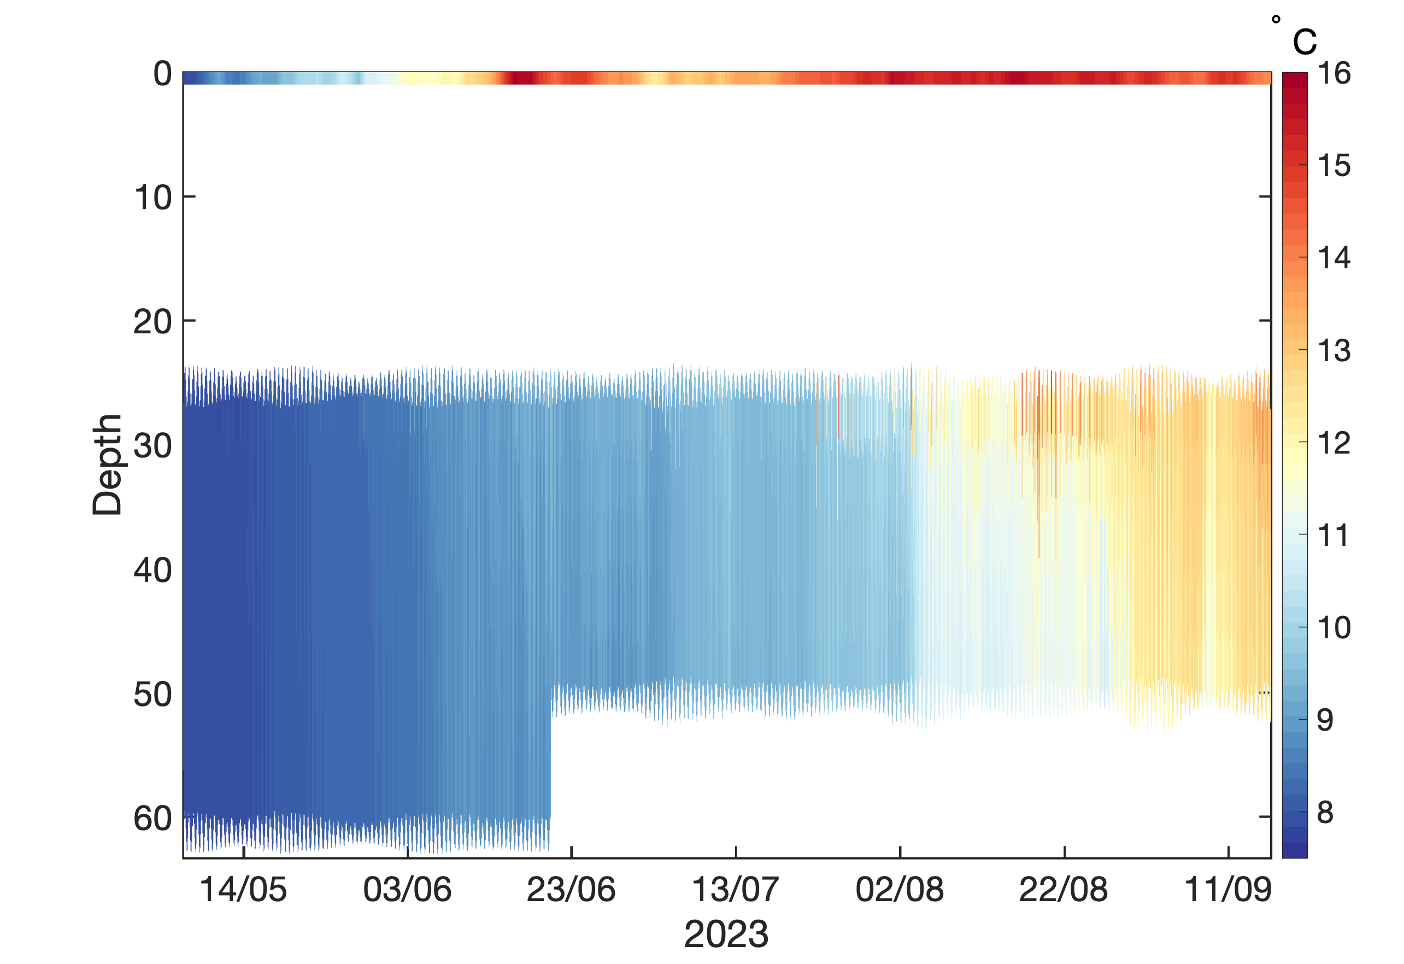
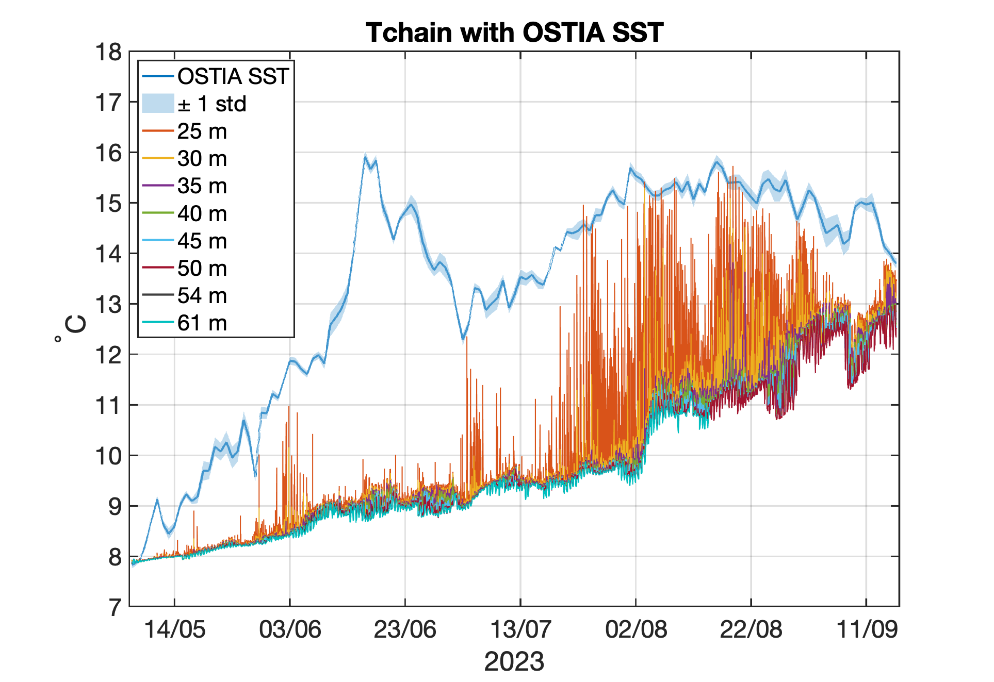
WP1 local scales: Temperature & Salinity mooring 2023
6th May – 19th September 2023
The T&S chain consisted of 13 temperature sensors
Including 3 CTDs (temperature, salinity and pressure)
5 m vertical spacing of sensors, sampling every min
A ship collision 3 days before recovery resulted in the loss of five sensors covering the top 25 m of the water column & collapse of the chain
Supplemented with Operational Sea Surface Temperature and Sea Ice Analysis (OSTIA) data
Preliminary analysis:
Site seasonally stratified a few days after deployment
Thermocline is mostly unresolved due to missing surface sensors
Rate of change of bottom mixed layer temperature changes significantly from August 2023 onwards
PELAgIO
OSTIA SST data
Data QC and analysis is ongoing.
Juliane Wihsgott, PML
Notes:
The different colours in the plot show temperature from 8 sensors at depths ranging from 25 to 60 m +OSTIA, and the legend refers to the average depths of these loggers during the deployment.

Slide 10
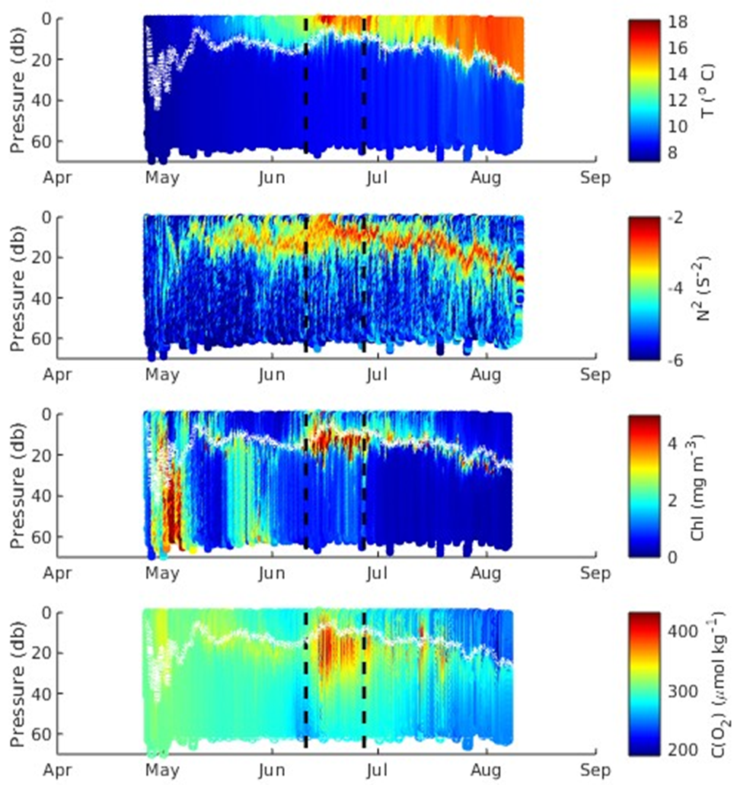
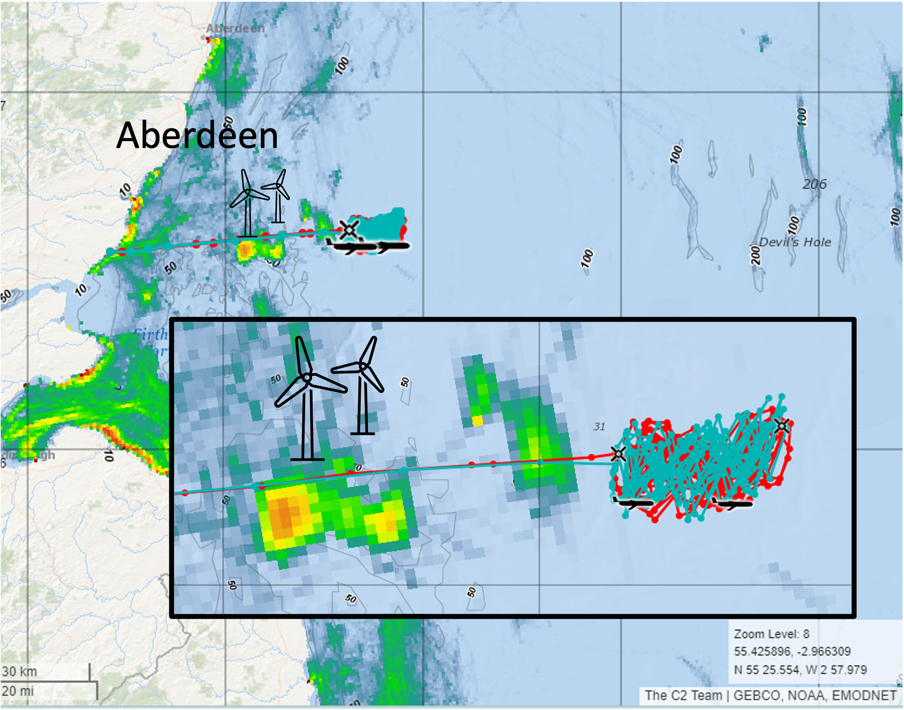
WP1 regional/shelf scales: Glider observations 2023
Gliders completed 36 transects between waypoints over 3 months
Sampled over 7 spring and neap periods.
Deepening of mixed layer from surface with enhanced winds
Comparing to models to separate high natural variability from the effect of the wind farms
Data to validate models and study local to regional effect of OWF
Charlotte Williams, NOC
Time (May to Aug)
Notes:
Gliders were implemented to provide an idea of spatial and temporal variability >10km from wind farm.
Two gliders measuring:
'Churchill': temperature, salinity, depth, chlorophyll and dissolved oxygen.
'Zephyr': temperature, salinity, depth, chlorophyll and dissolved oxygen and TKE dissipation rate.
Top panel is temperature, second is showing the strength of stratification calculated from the density, third panel is chlorophyll concentration and bottom panel is dissolved oxygen. Enhanced chlorophyll shown at the density interface – enhanced oxygen shown here as well.
Results will be used to validate the model and quantify local to regional footprint of OWF.

Slide 11
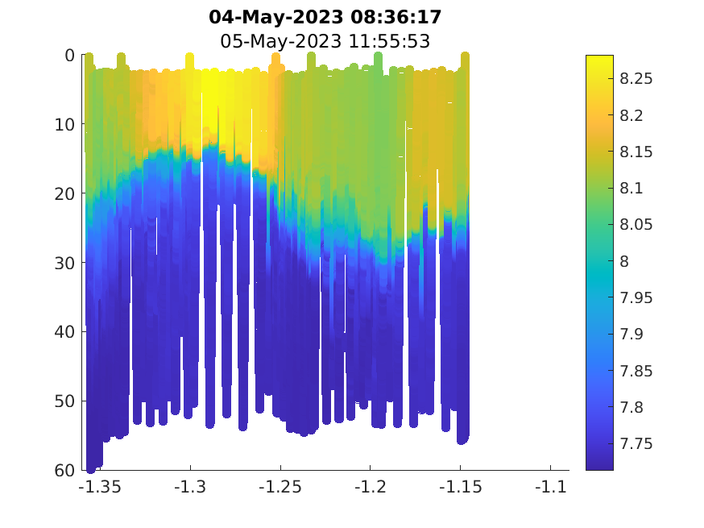
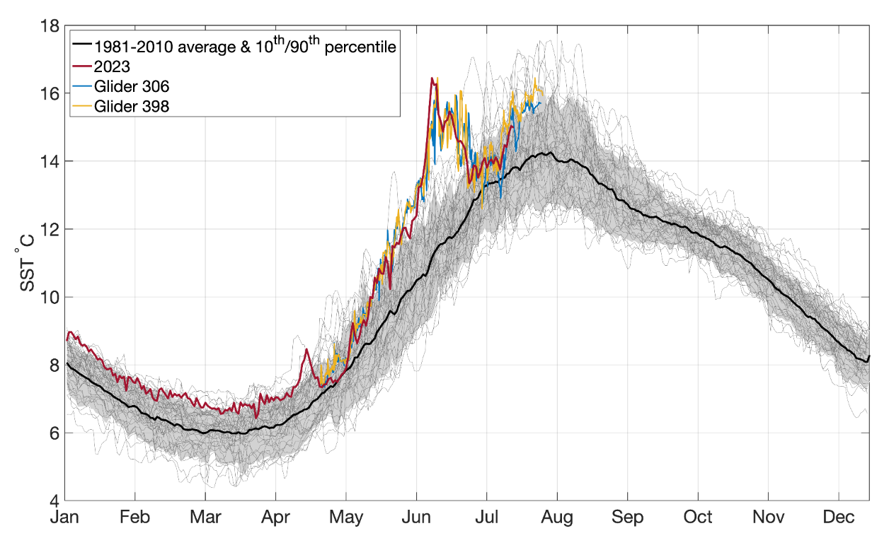
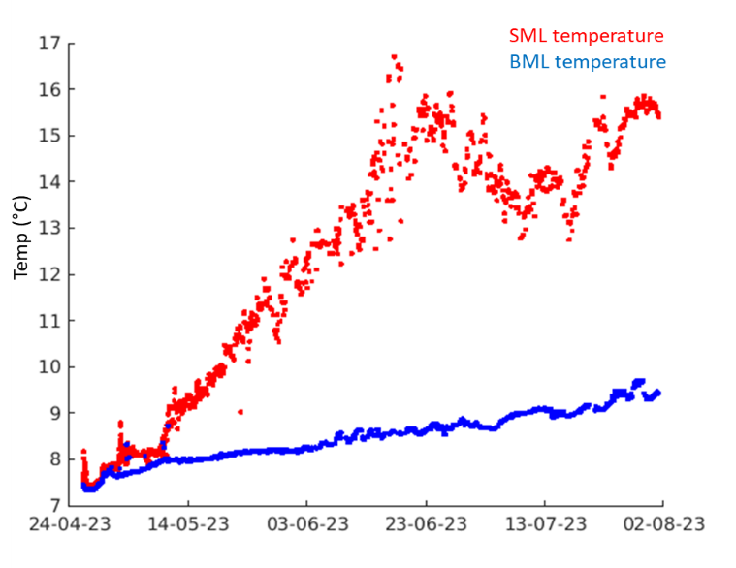
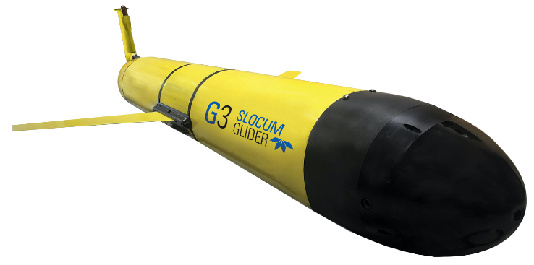
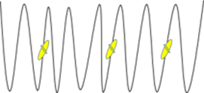
Charlotte Williams, NOC &
Juliane Wihsgott, PML
WP1 short and medium term temporal scales 2023
Short term variability
Interannual variability
PELAgIO gliders sampled within a hotspot of the marine heatwave - sea surface temperatures > 4^{oC} hotter than the seasonal average which classifies its severity as 'extreme' (Category 4).
Near surface temperature
Near bed temperature
Pressure (dbar)
Sea surface temperature ˚ C
Temperature ˚ C
Longitude
Example transect of temperature from W to E
Berthou et al., 2024
May- August 2023
No change in rate of warming in bottom water following the marine heatwave in June.
Temperature
Temperature
Depth
Marine Heatwave
Depth
The marine heatwave causes a shoaling of the surface mixed layer and stronger thermal stratification which prevents mixing of heat, nutrients and dissolved gasses (O₂) across the thermocline.
Notes:
Top left plot: Transect from SG to eastern waypoint; Gliders took 1-1.5 days to complete one leg of transect. - evidence of short term and temporal variability
Marine heatwave plot: Sea surface temperature from gliders (blue Zephyr and yellow Churchill) are overlaid to OSTIA SST product interpolated onto glider location (grey). Black plot shows 1981-2010 climatology with 10th/90th percentile band shown as shading which marks the threshold for a heat/coldwave.
OSTIA SST climatology
Increased strat from marine heatwave, N2 higher, reduction of mixing form SML to BML.

Slide 12
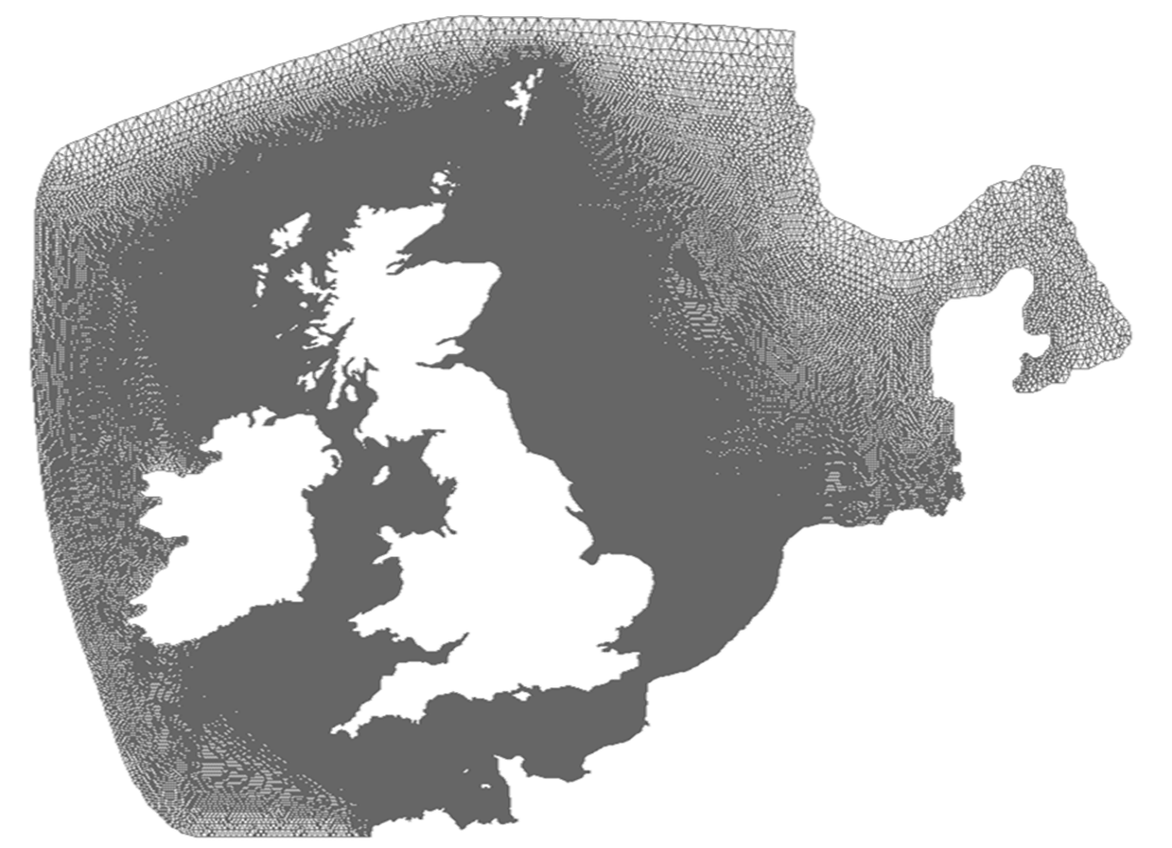
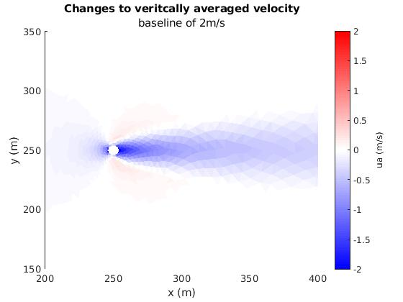
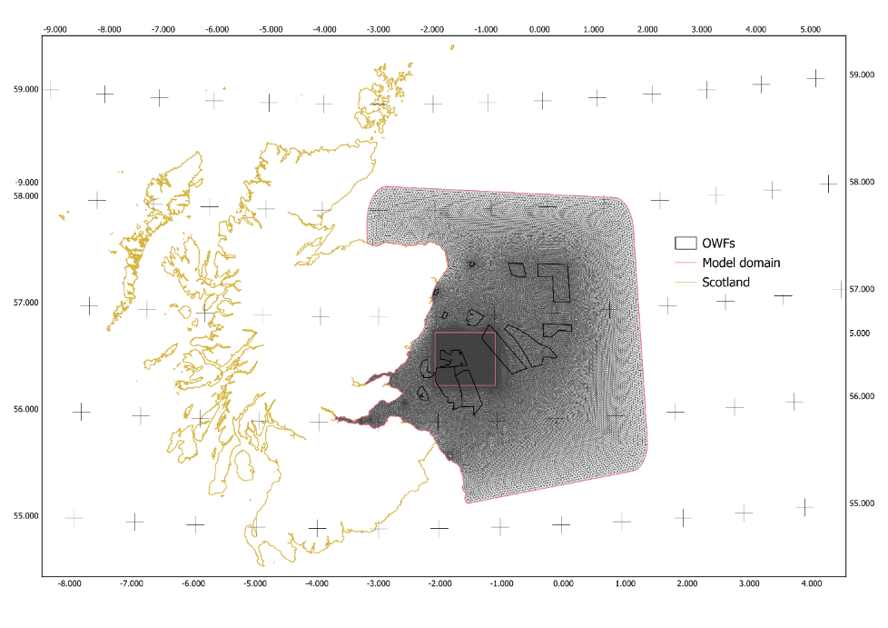
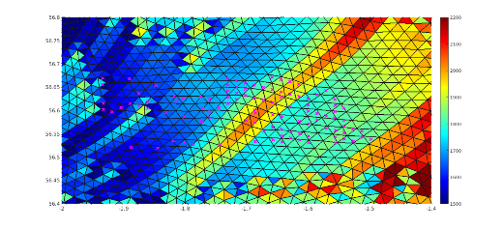
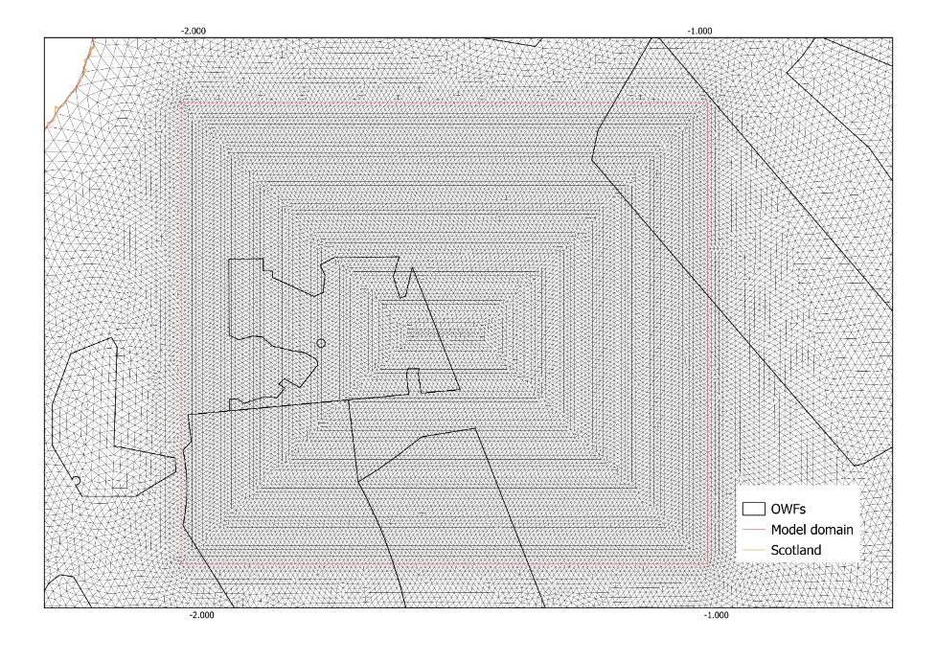
WP1: Modelling all Scales: Windfarm and Climate 3 SPATIAL SCALES
PELAgIO
Local: idealized channel Regional: FVCOM+ERSEM Shelf Wide: FVCOM+ERSEM+Climate
(10 m-1 km) (1-100 km) (>1000 km)
Resolving all proposed east coast OWFs
High resolution nested Seagreen grid
Notes:
A local SeaGreen Model & idealized channel that has been implemented and used to test the sensitivity to resolution & parameterizations (including non-hydrostatic runs).
Simulated channel (similar to the flume experiments done in Cazenave et al 2016) to isolate the exact effect of parameterisation on mixing in the downstream water column, using dry cells and comparing with the drag & mixing parameterizations.
The wind-wake parameterization will also be improved to included individual wakes and wakes interactions.
The underwater structure and wind-wake parameterizations, after being validated against turbulence, mixing and current observations, will be used in the regional FoF and in the shelf-wide North-West European Shelf FVCOM-ERSEM model runs.
Use of Field Data for Large-Scale
Estimates of depth resolved PP from gliders derived from chl-a, O2 measurements local to regional scales, including temporal and spatial variability and physical effects of OWF.
Underwater structure drag to be accurately parameterized (which has been implemented into FVCOM and the k-epsilon scheme in GOTM has been modified to include dissipation/ mixing due to underwater structure).

Slide 13
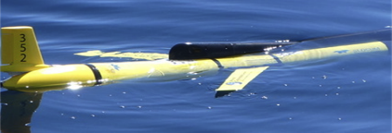
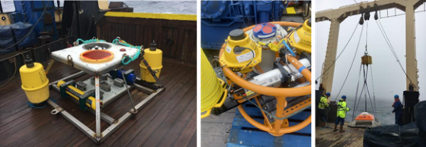
2 OWF MODEL PARAMETERISATIONS to include both mechanisms through which an OWF can change the mixing and stratification
PELAgIO
modified wind field to reproduce the ‘wind wake effect’: wind speed reduction in the wake of the OWF when it is operating
The 2023 and 2024 fieldwork data taken in the vicinity of Seagreen are being used to calibrate the drag and turbulence, and wind-wake OWFs parameterisations in models.
structure drag and mixing effects of the underwater structure: induced drag generated by the underwater structures and consequent induced mixing in the wake of the OWF
Modified from Shaw et al 2022

Slide 14
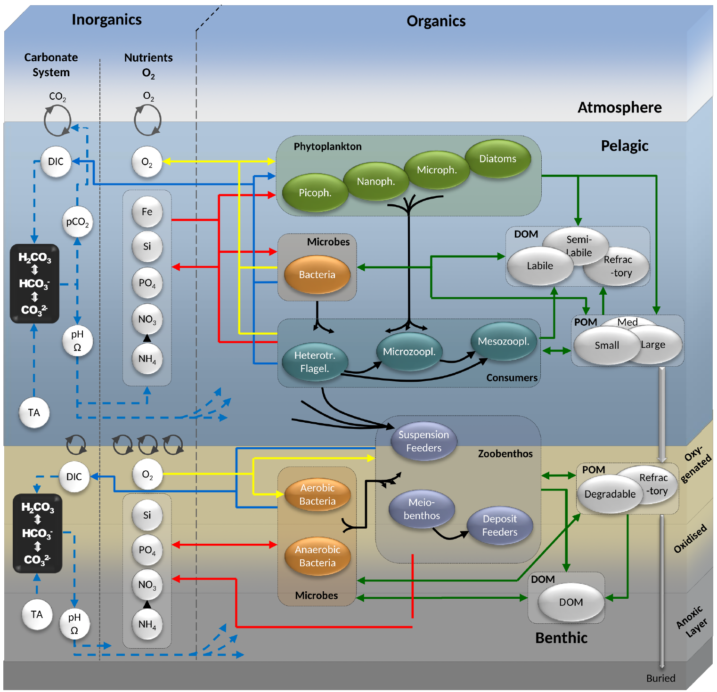
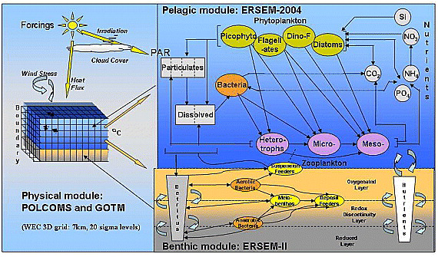
3 MODELS: HYDRODYNAMIC-TURBULENCE-BIOGEOCHEMISTRY
PELAgIO
ERSEM
Primary productivity
Dissolved oxygen
ChL-a
T, S,
u,v,w,k
FVCOM & GOTM
Modified from Ciavatta et al 2011
Modified from Butenschön et al 2016

Slide 15
Arianna Zampollo, UoA
Rory O'Hara Murray, MD
Wind-wake effects on biogeochemistry
PELAgIO
Chl-a MAX
Notes:
Michela and I have previously represented tidal turbine structures as a momentum sink, and we’re now using this again to represent the wind turbine structures. Just changing the drag coefficient and the cross-sectional area of the structures appropriately.
Michela has also recently now followed the approach of Rennau et al and additional terms to GOTM to represent the structure-induced friction, addition TKE production and rate of dissipation.
Michela and I have both now implemented this in our models and find that the changes to TKE lead to an order of magnitude greater change than just the momentum sink. This is the changes in mixing that I’ve outlined previously.
ROM:
Models sensitive to parameter values. Sensitivity analysis using high res model and observations
Above water impact (wind field changes)

Slide 16
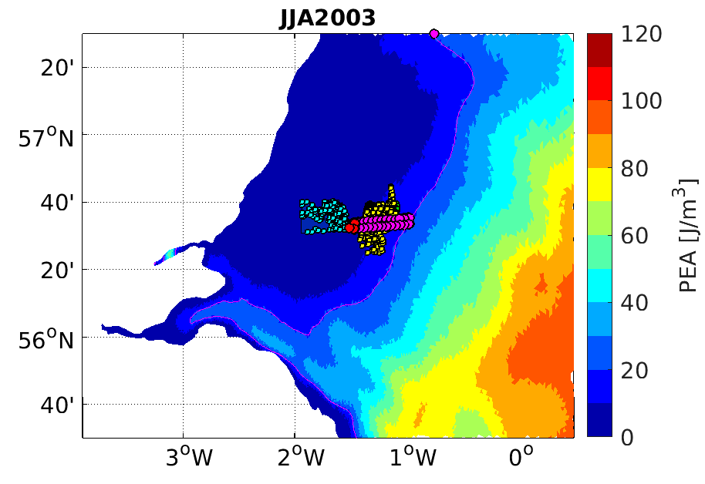
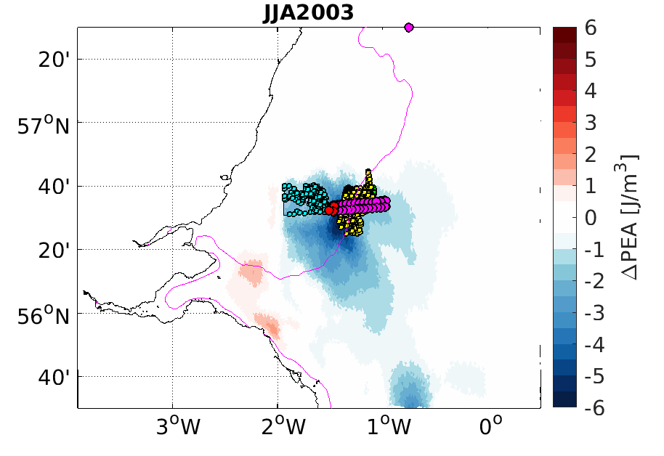
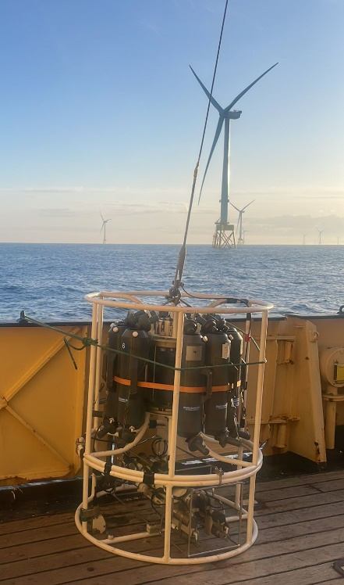
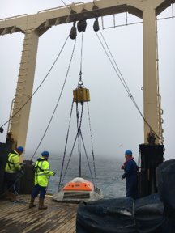
Effects of structures drag & mixing
Michela De Dominicis, NOC
PELAgIO
SUMMER seasonal changes – Potential Energy Anomaly
GLIDERS
MOORINGS
CTD

Slide 17
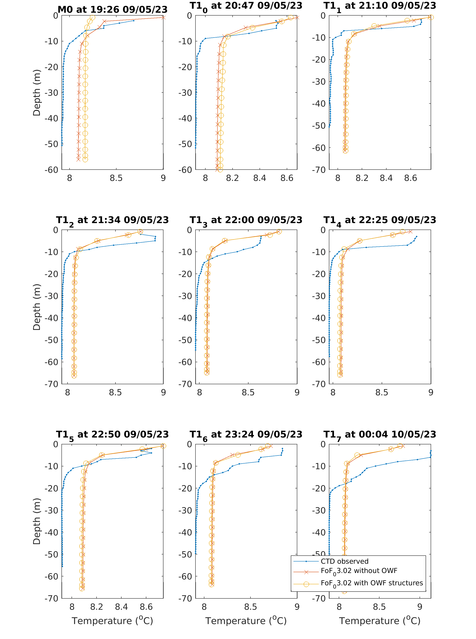
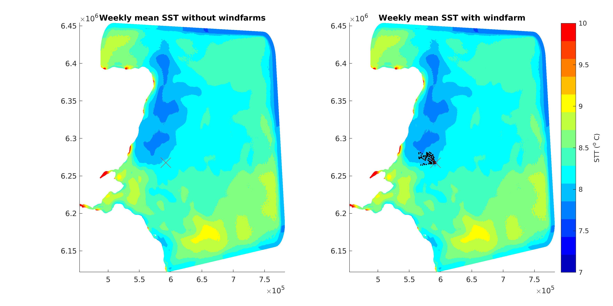
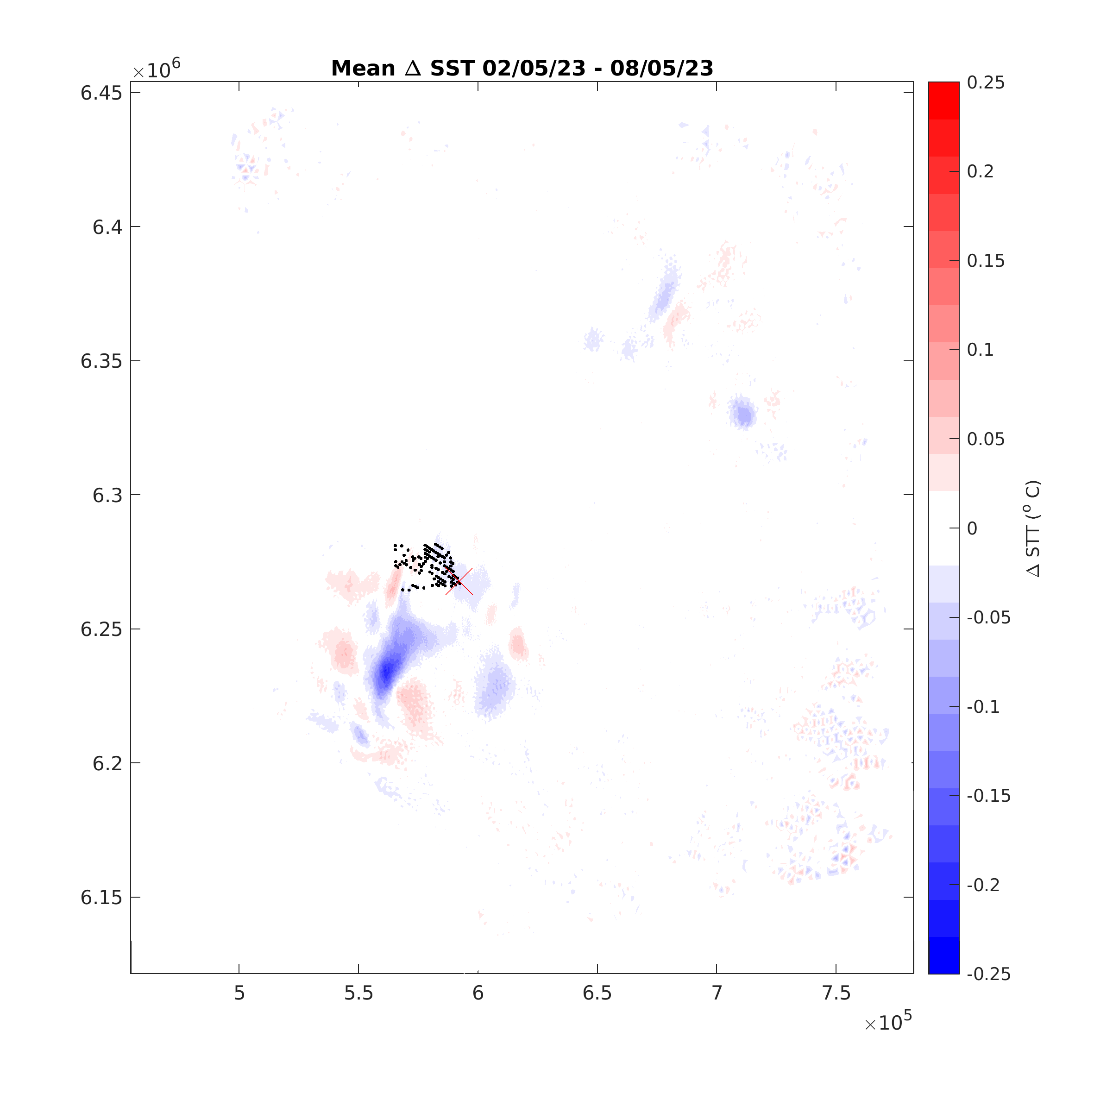
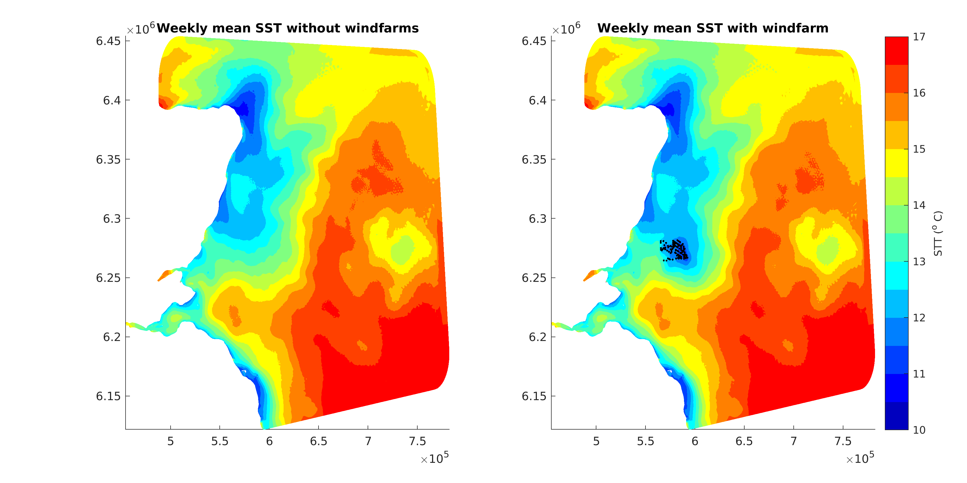
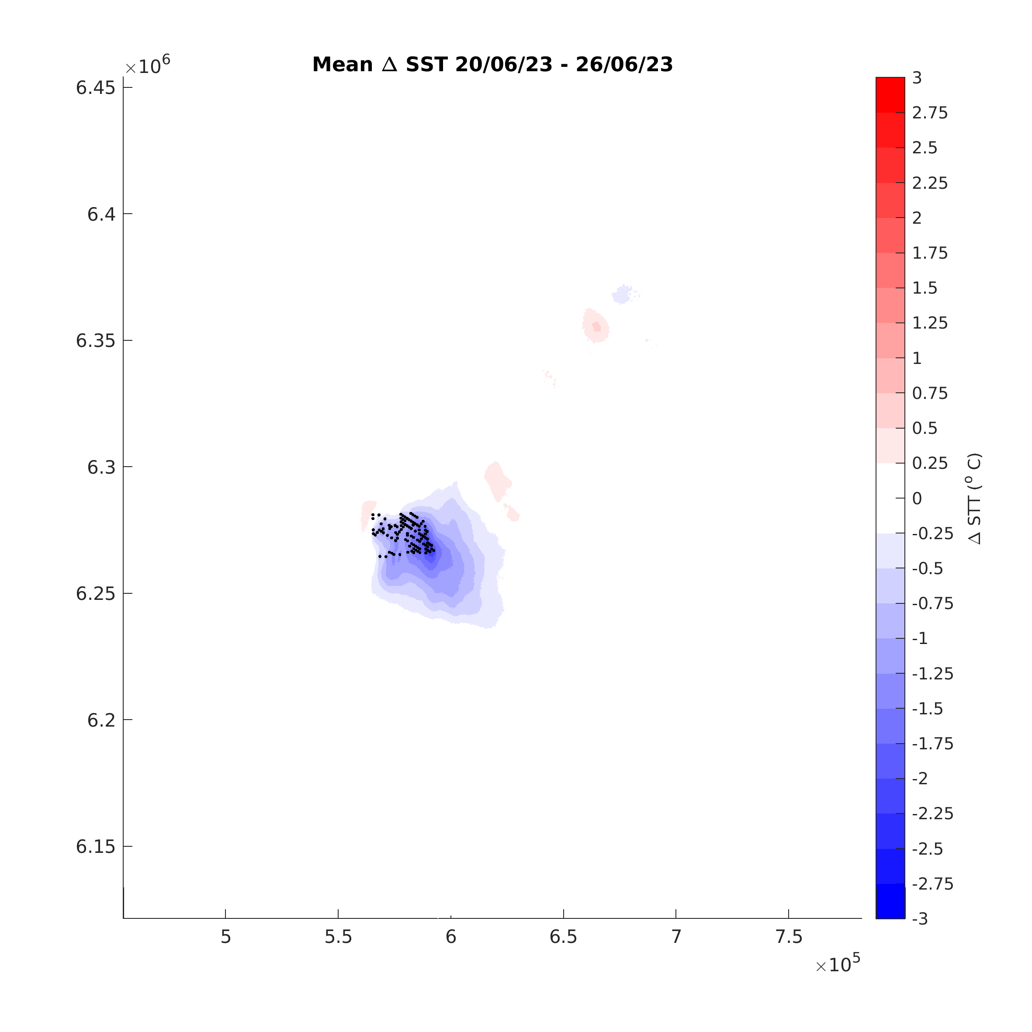
Temperature comparison with 2023 observations
Effects of structures drag & mixing
Rory O'Hara Murray, MD
PELAgIO
MAY 2023
JUNE 2023

Slide 18
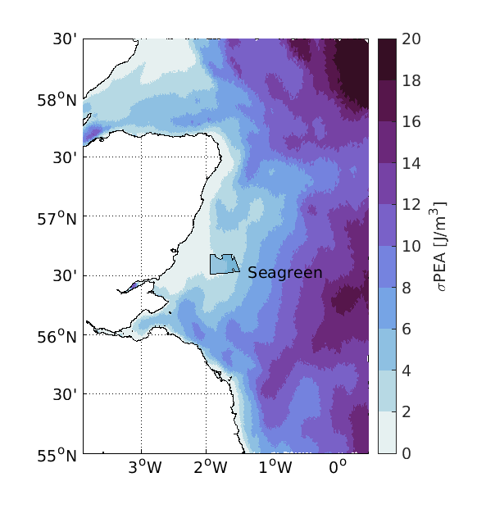
Shelf scale OWF changes vs climate change
Michela De Dominicis, NOC
Jenny Jardine, NOC
PELAgIO
Change due
to offshore wind structures
(work in progress, PELAgIO)
Present climate
STRATIFICATION (PEA)
NATURAL VARIABILITY
(work in progress, PELAgIO)
Climate change
STRATIFICATION (PEA)
We need multi-year model simulations with/without OWFs to disentangle natural variability (and climate change) from OWFs induced changes.
Notes:
Negative NOA in 2010 (unusual)
Do winfarm mitigate/etc effects of NAO?
List ersem parameters jenny's including.
RCP8.5 but maybe other ssp scenarios are ready?
How far into the future? and how many wind farms?
Wind sceanrios - practical work putting dots on a map.
One WF scenario for JJ
Arianna to do 2-3 I think.

Slide 19
REGIONAL & SHELF WIDE OUTPUTS
PELAgIO
2008-2017
FVCOM-ERSEM
2010-2012
FVCOM-ERSEM ​
2008-2017 FVCOM-ERSEM WITH OWFs
2050 RCP8.5 FVCOM-ERSEM
WITH/WITHOUT 2050 OWFs
UNDER CONSTRUCTION
UNDER CONSTRUCTION

Slide 21
Sampling challenges in offshore windfarms generate innovation in marine autonomous systems
Josh Lawrence & Paul Fernandes

Slide 22
ECOWINGS goal: understand cumulative impacts of OWFs on seabirds and the wider ecosystem
This work:
Aims to quantify fish distributions in and around OWFs
Relate fish data to seabird distributions
But how?
The scientific echosounder
Traditional vessels:
Large
Navigational constraints
Risky:
Personnel
Infrastructure
Other vessels
Expensive
Large carbon footprint
Seabed

Slide 23
AUV
Alternative platforms will overcome these challenges
Aeroplane
USV
USV
Small
Safe
Low carbon
Cheap(er)
Acoustic view?
Unsampled
AUV
Innovative sampling and modelling of the distribution of seabirds and their prey
USV

Slide 24
Innovation required for surveying OWFs: USV
Survey requirements:
‘Long’ range
Communications
Echosounder
Started from ‘bare bones’ vessel:
Floated(!)
Battery only
One camera
Limited comms
No echosounder
20 nmi
Now:
Still floats
Battery + diesel generator
360° cameras
Over the horizon comms
Starlink
+ backup systems
Echosounder
Drop-keel for data quality
2 years ago…
6 weeks ago…

Slide 25
Recent developments and plans
Sea trials October 2024
USV @ Millport
First data collection with newly fitted echosounder
High quality data
All communications & control systems operational
USV Data
High
0
Fish schools
25
Seabed
Depth (m)
Echo
strength
50
75
400
1200
2000
2800
Distance (m)
Low

Slide 26
Recent developments and plans
Future plans:
Additional USV developments:
VHF
Fuel tank
Survey preparation over winter
MCA certification
Liaise with OWF operators
Data collection from April 2025 onwards
Any questions?
(Also see poster!)
Sea trials October 2024
USV @ Millport
First data collection with newly fitted echosounder
High quality data
All communications & control systems operational

Slide 27
Assessment of impacts associated with electromagnetic fields produced by HV submarine cables
Joanna Rzempołuch¹, George Callender¹, Justin Dix², Martin Solan², Jasmin Godbold², Oscar Ward³, Liesl van der Blackman², Liam Ferdinand³, Kevin Goddard¹, Sunny Chaudhary¹, Paul Lewin¹, and Huw Powell¹
¹Tony Davies High Voltage Laboratory, University of Southampton, Southampton, United Kingdom
²Ocean and Earth Sciences, University of Southampton, Southampton, United Kingdom
³ERM Limited, Norwich
20th of November 2024
email: jr9g20@soton.ac.uk

Slide 28
Research Problem
Offshore infrastructure
Marine animals
Question: Is the increasingly present infrastructure impacting the marine life?

Slide 29
Overview
Research Problem
Modelling of EMFs Produced by HV Subsea Cables (Poster 1)
Meta-analysis of the impacts of EMF on marine ecosystems: what do we actually know? (Poster 2)
SCAMPI (Synthetic Cable for the Assessment of Marine Power Impacts) (Poster 3)

Slide 30
Poster 1: Modelling of EMFs produced by HV submarine cables
Problems with existing approaches for EMFs calculation:
Numerical approaches:
Analytical approaches:
complexity, universality, computational cost, accessibility
accuracy, complexity, accessibility

Slide 31
Poster 1: Modelling of EMFs produced by HV submarine cables
Aim: Calculation of EMFs from different subsea cable systems at low computational cost, in an accessible way with a good level of accuracy.
Implementation of analytical solutions of varying complexity through MATLAB/Python code validated by numerical solutions

Slide 32
Poster 2: Meta-analysis
Factors analysed include an assessment of the magnetic and electric field strengths, duration of exposure, nature of source (AC vs DC) and the species type and life stage.
AC
The fields used in literature have been compared with data derived from physics-based models (Poster 1) and with full consideration of the installation and operating conditions.
These insights have been used to inform a new set of experiments to be undertaken as part of (SCAMPI: Poster 3).
AC Cable Surface
0.5 m
1 m
Meta-analysis review suggests from 26+ experiments that there are no demonstrable effects until within 0.5 m of high load cable and realistically not until existing on the cable surface.
26+ experiments
2 m
Negative Effect
Positive Effect
No Effect

Slide 33
Poster 3: SCAMPI (Synthetic Cable for the Assessment of Marine Power Impacts
Aim: Design of a device that recreates the EMFs created by HV submarine cable systems (i.e. the magnitude, distribution and orientation of the fields) that can be used for marine biology experiments.
Modelling and Design
Testing
+Other Considerations

Slide 35
Quantifying the impact of offshore wind farm infrastructure using Earth Observation
PELAgIO
Tim Smyth, Juliane Wihsgott, Dan Clewley, Silvia Pardo, NEODAAS

Slide 36
What are we looking for?
“Smoking gun” of evidence that offshore wind infrastructure disrupts the marine ecosystem
PELAgIO
Dorrell et al., (2022)

Slide 37
Evidence investigation #1
Ocean Colour (chlorophyll)
Anomaly plots vs 1998 – 2020 climatology
Verdict
Spatial resolution too coarse
Temporal resolution too coarse
Coverage too patchy
Natural spatio-temporal variability too high
PELAgIO

Slide 38
Evidence investigation #2
Sea Surface Temperature (SST)
Anomaly plots vs 1991 – 2020 climatology
Verdict
Spatial resolution too coarse
Temporal resolution too coarse
Coverage too patchy
Natural spatio-temporal variability too high
PELAgIO

Slide 39
PELAgIO
Evidence investigation #3
Synthetic Aperture Radar (SAR)
Do we trust SAR to give accurate wind retrievals? YES

Slide 40
Evidence investigation #3
PELAgIO
Synthetic Aperture Radar (SAR)
What do the data look like?
Evidence for both deceleration and acceleration behind turbines
11/09/2023
28/08/2023

Slide 41
Evidence investigation #3
PELAgIO
Synthetic Aperture Radar (SAR)
Both deceleration and acceleration observed previously
Function of atmospheric stability (Hasager et al., 2024)

Slide 42
Evidence investigation #3
PELAgIO
Synthetic Aperture Radar (SAR)
Quantifying impact: relative wind speed relative to upwind reference
Turbine location
Turbine operating

Slide 43
Evidence investigation #3
PELAgIO
Synthetic Aperture Radar (SAR)
Quantifying impact: is deficit linked to turbine operation?

Slide 44
Evidence investigation #3
PELAgIO
Synthetic Aperture Radar (SAR)
Quantifying impact: Looking at convergence / divergence patterns
Divergence
Speed up
Convergence
Slow down

Slide 45
Have we found what we’re looking for?
“Smoking gun” of evidence that offshore wind infrastructure disrupts the marine ecosystem
Not directly, but evidence that we can further use to quantify impacts on wind driven upwelling
PELAgIO
Dorrell et al., (2022)

