Slide 1
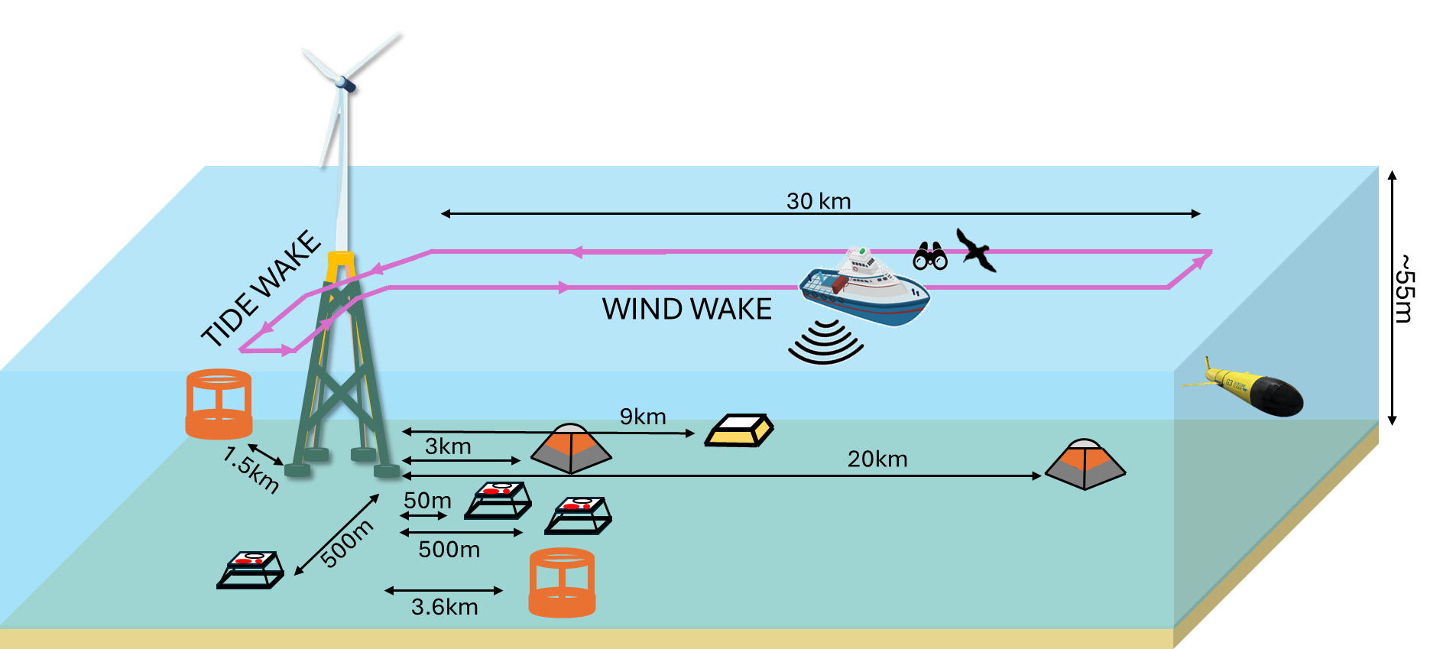


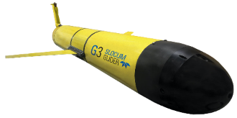
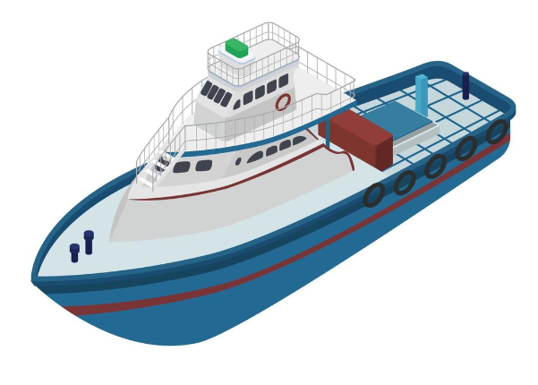
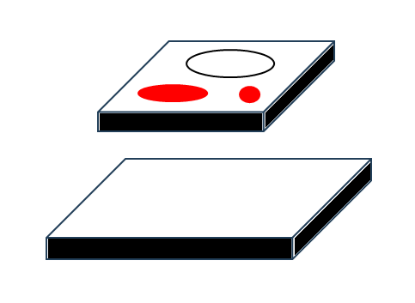

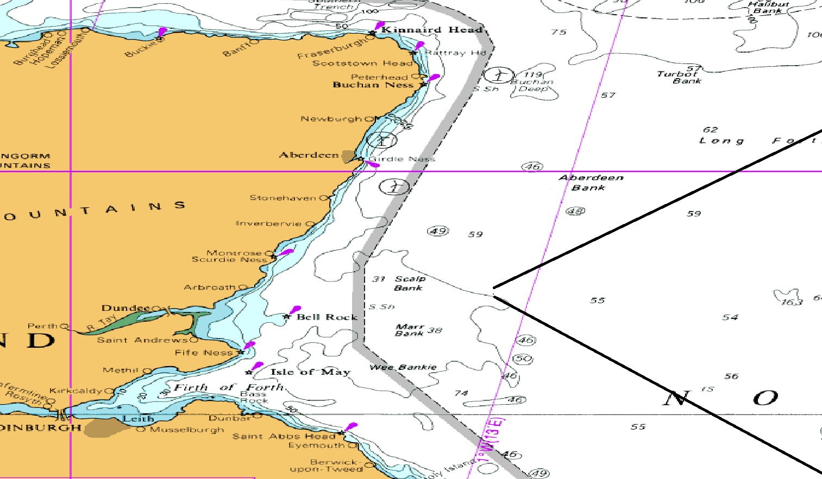
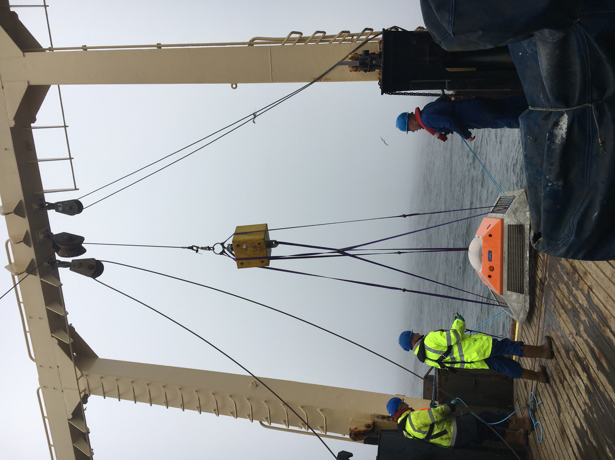
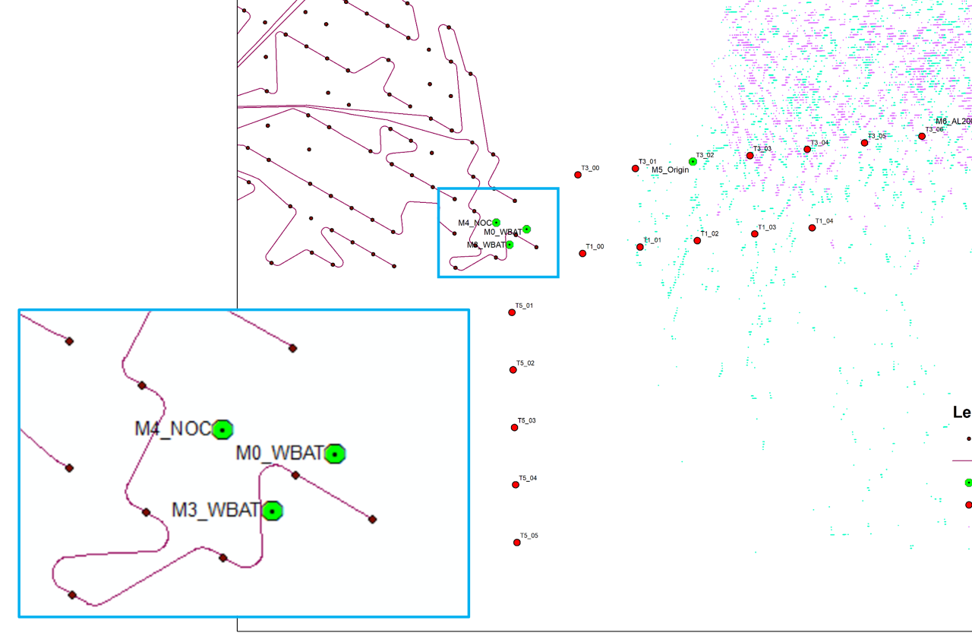

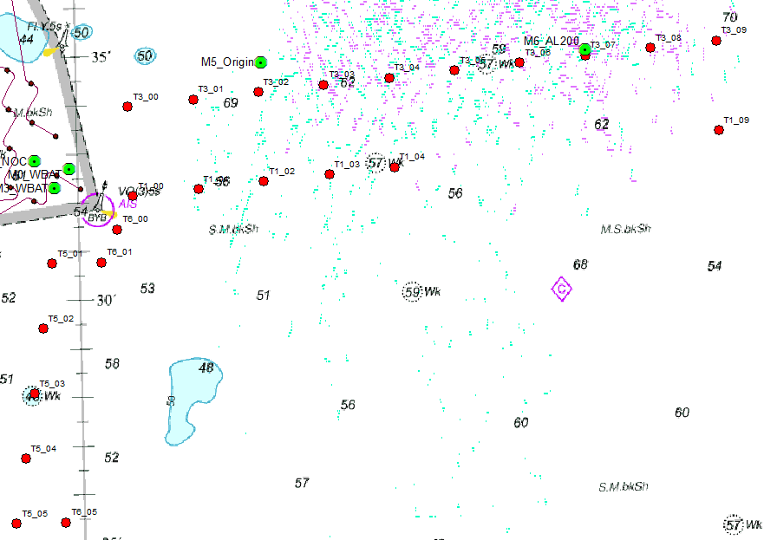
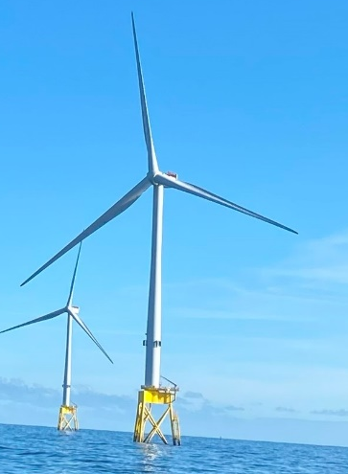
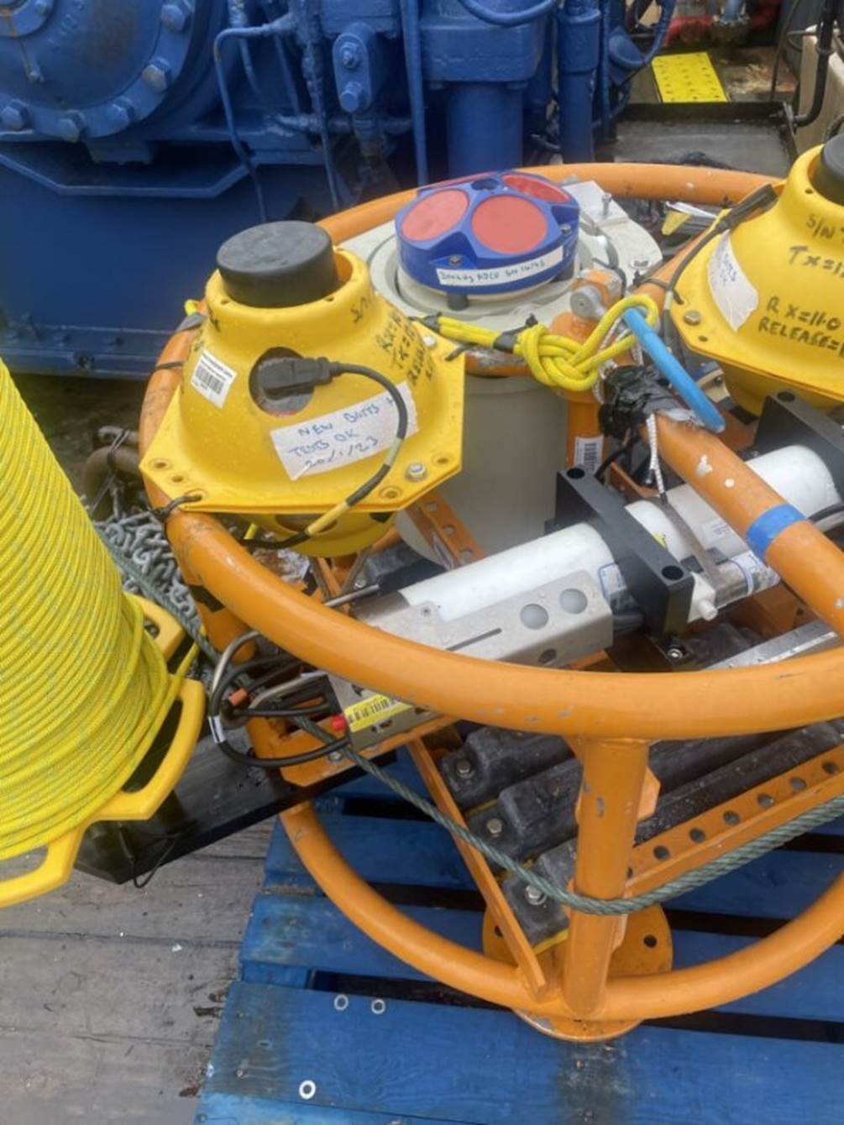
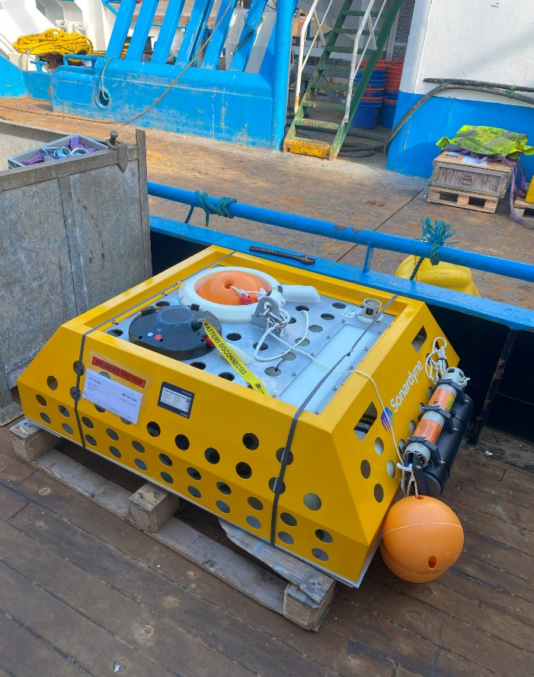
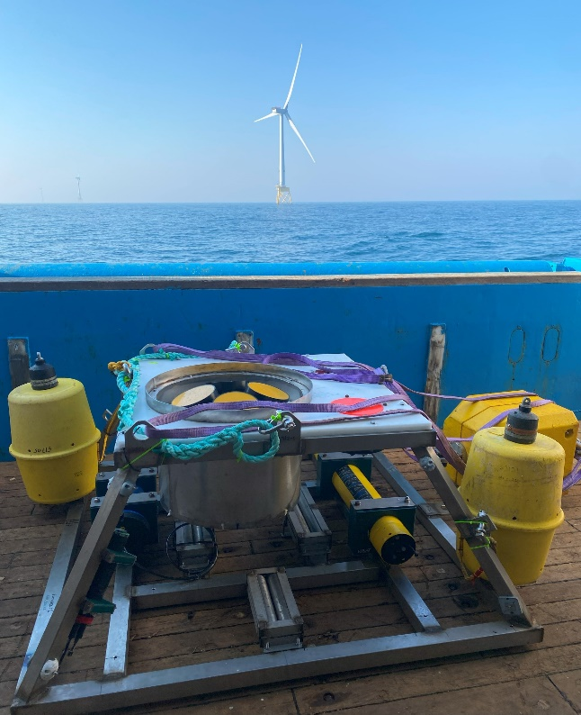
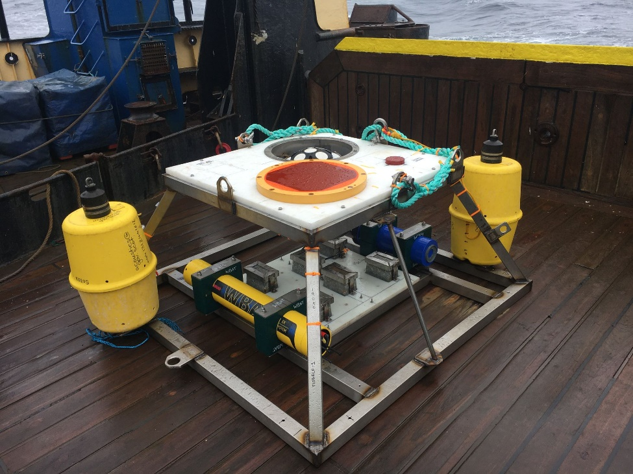
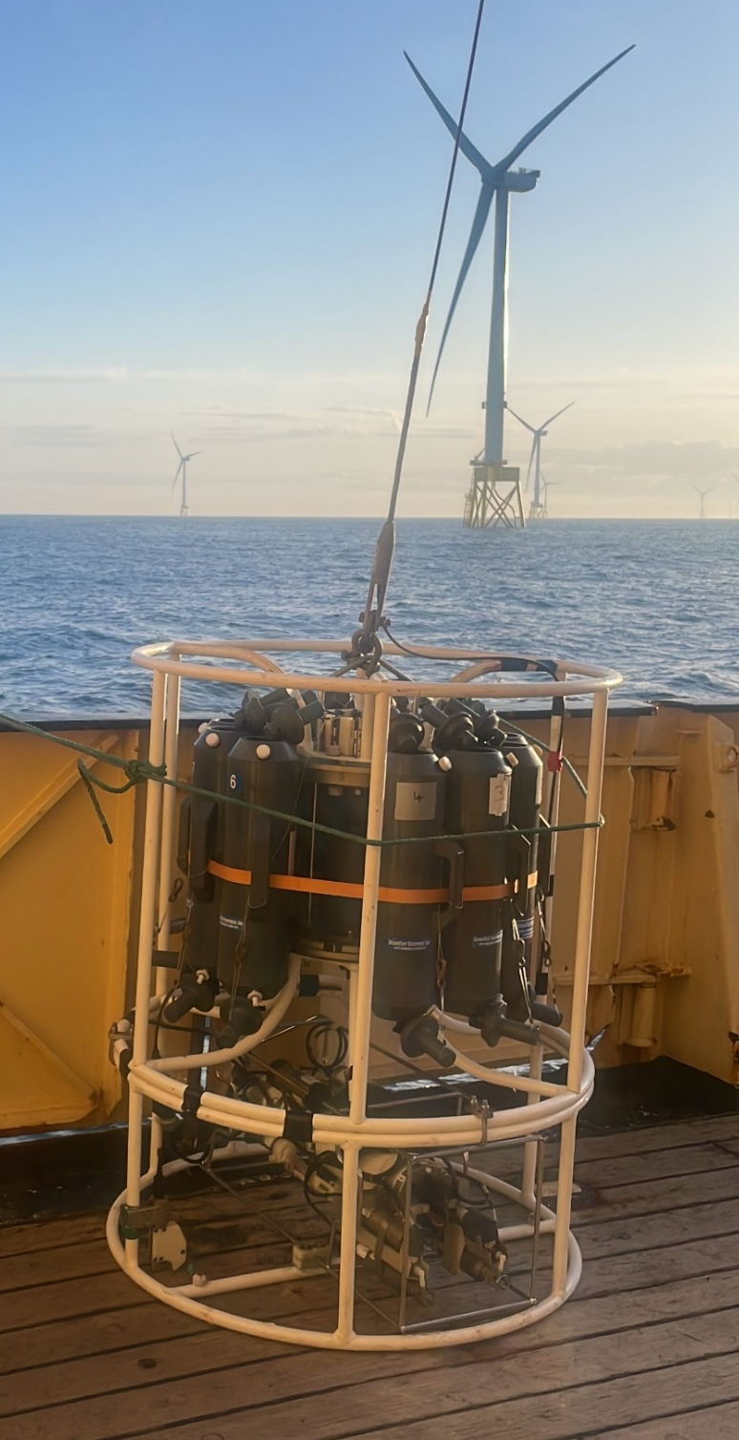
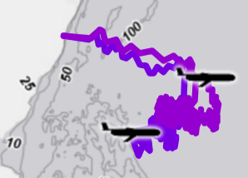


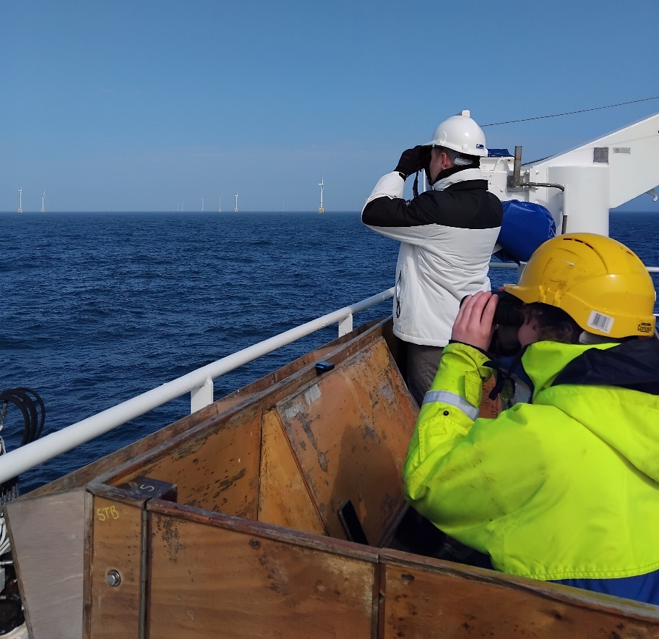
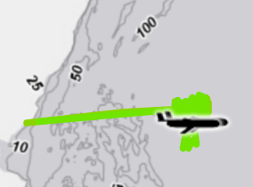

Multi-platform fieldwork in support of the Physics-to-Ecosystem Assessment of Offshore Windfarms (PELAgIO)
Alejandro Gallego (alejandro.gallego@gov.scot)
Marine Directorate, Scottish Government (and the PELAgIO team, MARS, and scientists and crew of RV Corystes and MRV Scotia)
Overview
Moorings: - current profilers - CTD - echosounders | Ship-based: - CTD + ass. sensors - water biogeochemistry - acoustic transects - seabird observations | Gliders: - CTD + ass. sensors - turbulence
Local scale
Regional scale
Julie Salvetat
2023 prevailing wind wake
WIND WAKE
CTD stations and
acoustic transects
2024 prevailing wind and tidal wakes
CTD stations
TIDE WAKE
Moored instrumentation
Name | Frame | Instrumentation | Depth (m) | Distance to nearest turbine (approx.) | Deployment period
M0 | Steel bottom frame | 500 kHz ADCP 38 kHz echosounder 200 kHz echosounder | 58 | 0.5 km | 6 May – 15 Jun 2023 (40 d)
N29 | Steel bottom frame | 500 kHz ADCP 38 kHz echosounder 200 kHz echosounder | 55 | 50 m | 10 Aug 2023 – 07 Feb 2024 (181 d)
M1 | AL200 TRBM | 250 kHz ADCP T sensor | 62 | 3.6 km | 6 May – 19 Sep 2023 (136 d)
M2 | NOC Steel bottom lander | 300 kHz ADCP CTD Thermistor chain | 64 | 3.0 km | 6 May – 19 Sep 2023 (136 d)
M0 | Steel bottom frame | 500 kHz ADCP 38 kHz echosounder 200 kHz echosounder | 58 | 0.5 km | 4 May – 25 Sep 2024 (144 d)
M3 | Steel bottom frame | 250 kHz ADCP CTD 38 kHz echosounder 120 kHz echosounder | 57 | 0.5 km | 17 May – 25 Sep 2024 (131 d)
M4 | NOC Steel bottom lander | 300 kHz ADCP CTD Thermistor chain | 58 | 1.5 km | 4 May – 25 Sep 2024 (144 d)
M5 | Sonardyne lander | 600 kHz ADCP | 70 | 9 km | 4 May – 8 Oct 2024 (157 d)
M6 | AL200 TRBM | 250 kHz ADCP | 70 | 20 km | 2 May – 25 Sep 2024 (146 d)
Gliders 2023 (Apr-Aug)
> 25 h EK60 acoustic surveys (along CTD survey tracks)
- spring and autumn 2023
- spring and autumn 2024
Seabird observations:
Spring 2023 and 2024
(concurrent with daytime EK60 acoustic transects)
Gliders 2024 (Jun-Aug)
Contacts: CTD rory.murray@gov.scot, michael.bargus@gov.scot, barbara.berx@gov.scot, – ADCP rory.murray@gov.scot , jwi@pml.ac.uk - gliders chwill@noc.ac.uk, jwi@pml.ac.uk – bird observations j.waggitt@bangor.ac.uk, benjamin.williamson@uhi.ac.uk – active acoustics julie.salvetat@uhi.ac.uk, benjamin.williamson@uhi.ac.uk
Acknowledgements : Scientists and crew on the MRV Scotia and RV Corystes cruises, MARS team, Marine Laboratory Engineering workshop, PELAgIO team and anyone else involved in the planning and execution of this fieldwork
Picture credit : Caitlin Harris, Rory O’Hara Murray, Charlotte Williams, Julie Salvetat
PELAgIO

